Slide 1

CBSE Affiliation No.: 3330373
School Code: 15901
Contact No. :
98260-09199
MSP PUBLIC SCHOOL
Village - Junadih , Post - Jamgaon, Dist - Raigarh, 496001
Website – www.mspschool.in
Email – principal@mspschool.in , info@mspschool.in
accounts@mspschool.in

Slide 2
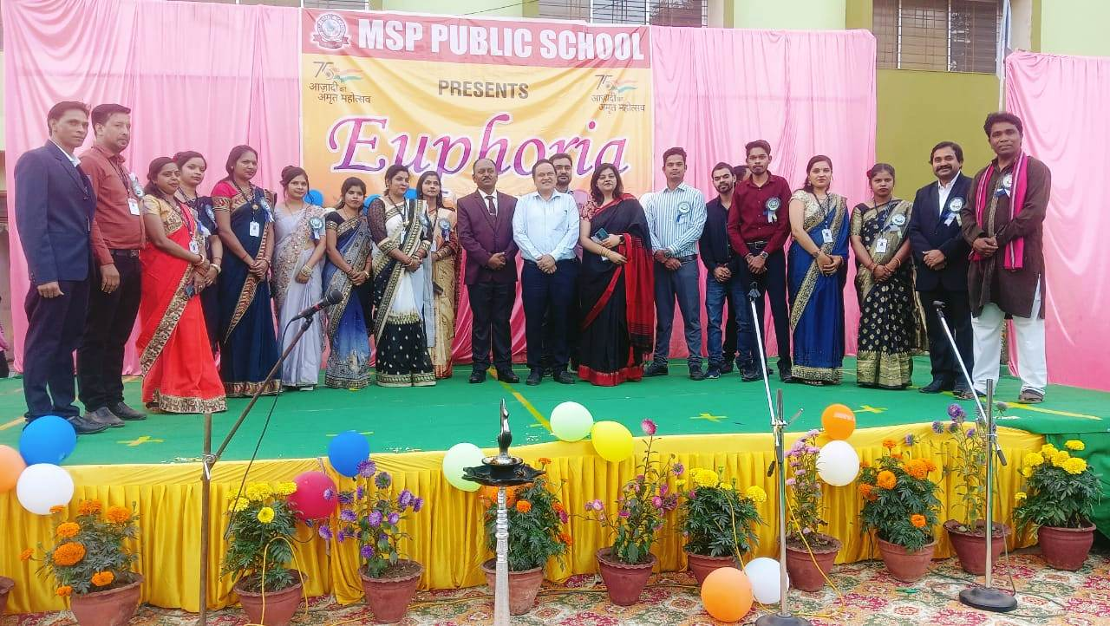
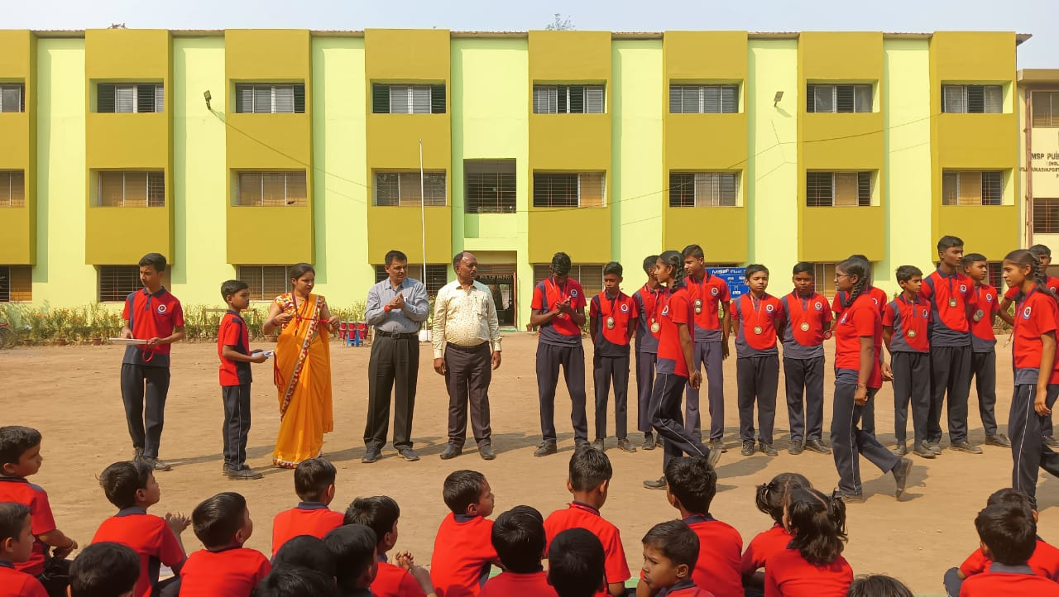
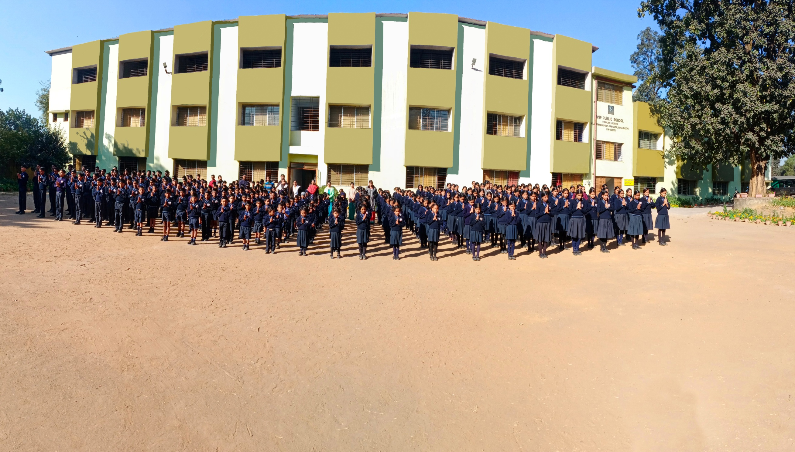

ANNUAL CALENDAR 2023-24
INFORMATION GIVEN IN ...
Red – School Holiday
Blue – Activity
MSP Public School Team
Green – Examinations
Purple – PTM

Slide 3
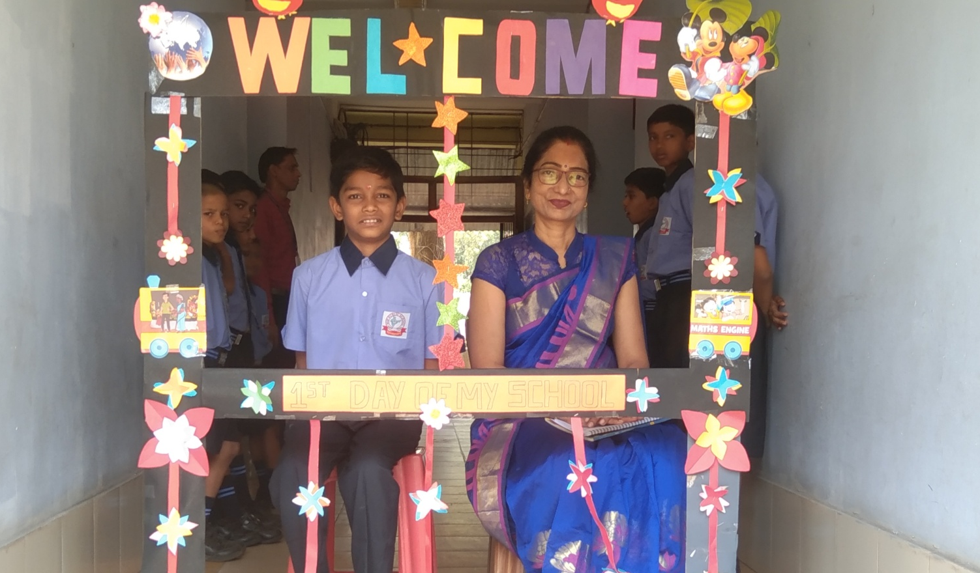
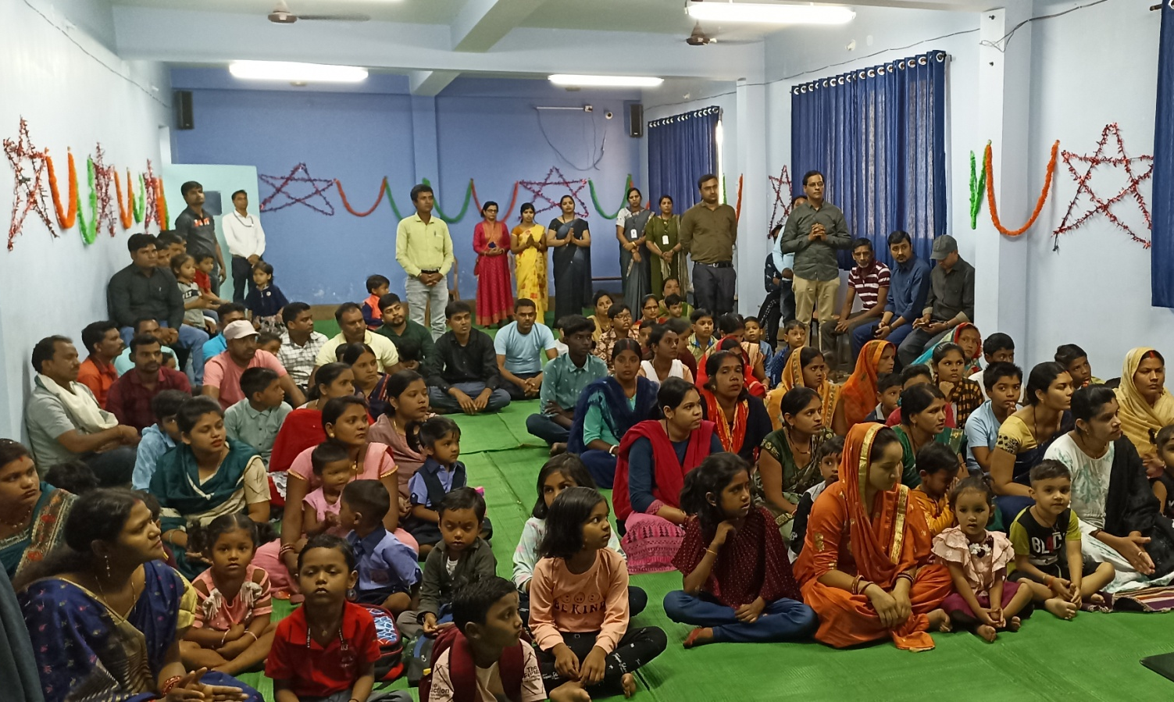
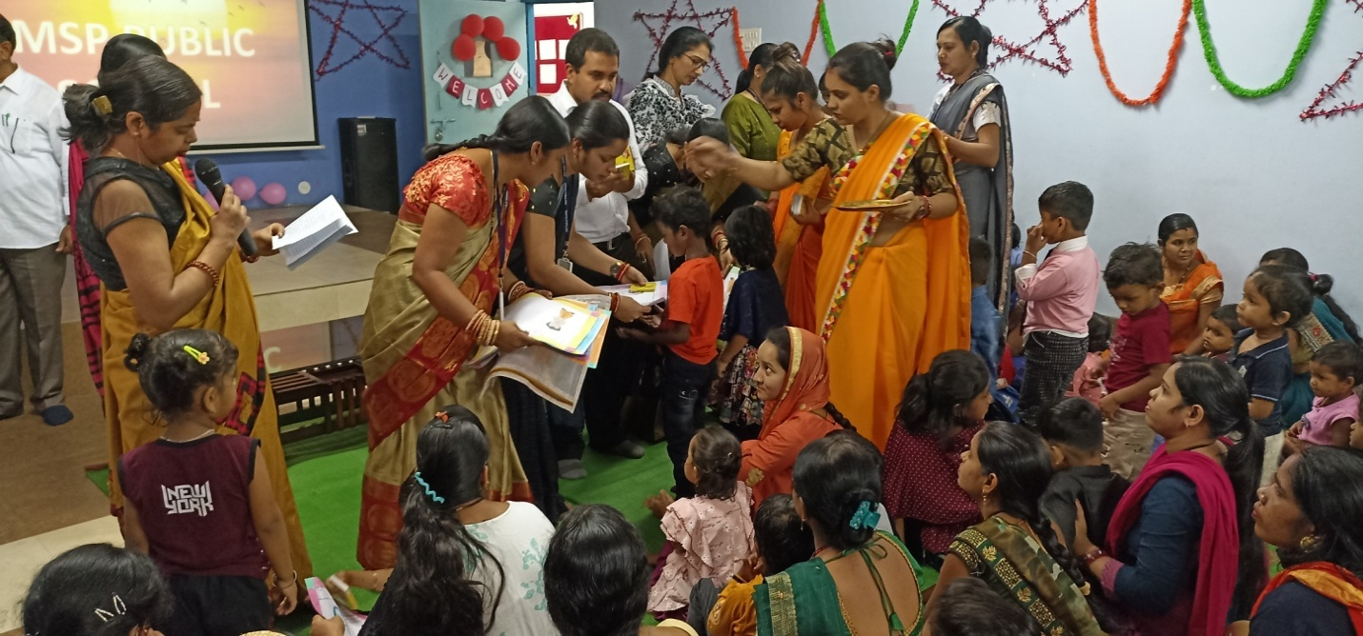


APRIL - 2023
4 - Mahaveer Jayanti.
6 - World Health Day.
7 - Good Friday.
8 - Vidya Aarambh.
10 - April New Session
begins.
14 - Ambedkar Jayanti.
22 - Eid-ul-fitr.
VIDYA AARAMBH
SUN | MON | TUE | WED | THU | FRI | SAT
 |  |  |  |  |  | 1
2 | 3 | 4 | 5 | 6 | 7 | 8
9 | 10 | 11 | 12 | 13 | 14 | 15
16 | 17 | 18 | 19 | 20 | 21 | 22
23 | 24 | 25 | 26 | 27 | 28 | 29
30
MSP PUBLIC SCHOOL

Slide 4
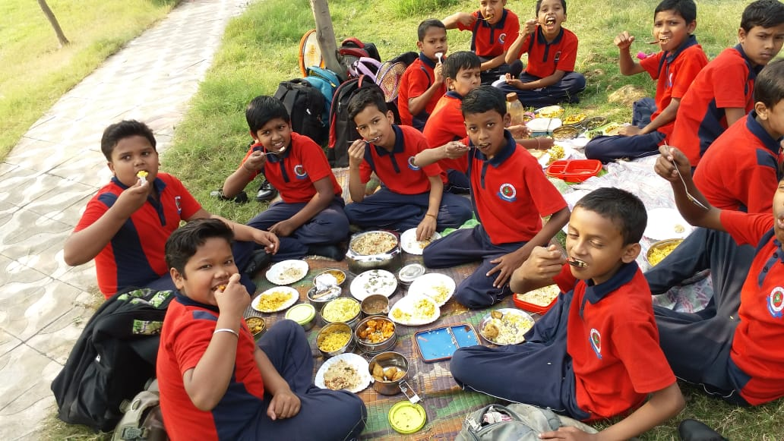
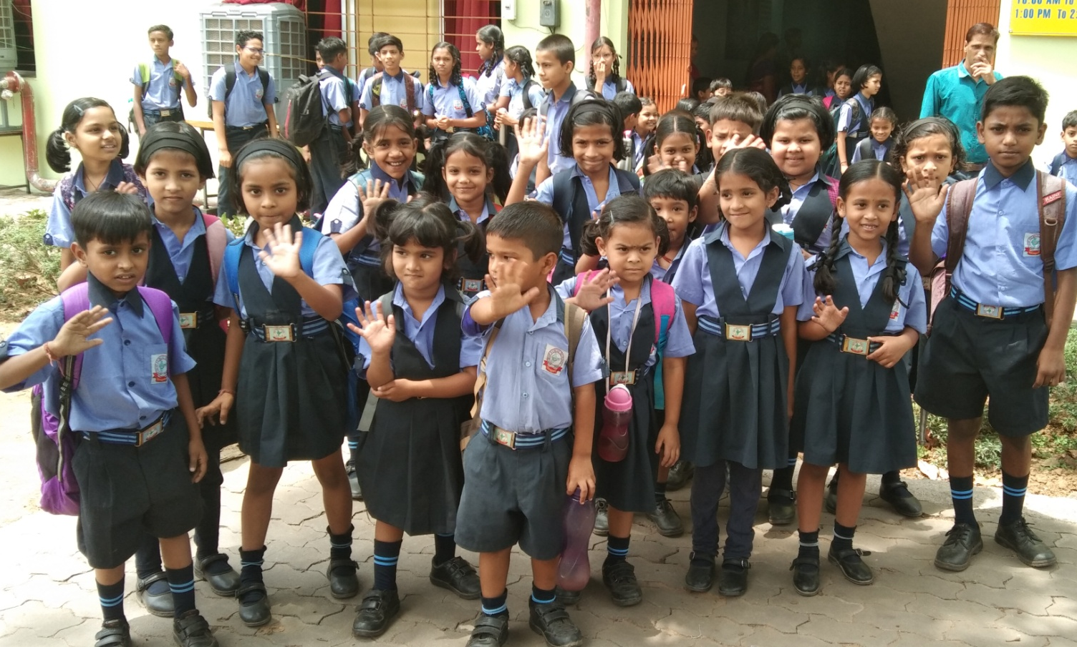
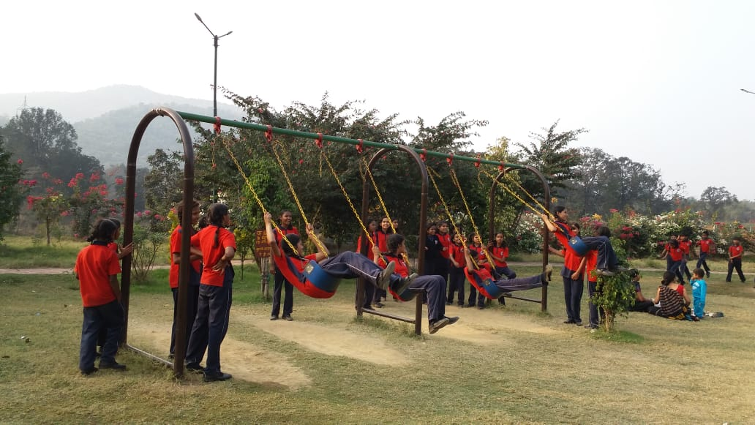
MAY - 2023
10 - Summer Vacation begins for KG to X.
SUMMER VACATION
SUN | MON | TUE | WED | THU | FRI | SAT
 | 1 | 2 | 3 | 4 | 5 | 6
7 | 8 | 9 | 10 | 11 | 12 | 13
14 | 15 | 16 | 17 | 18 | 19 | 20
21 | 22 | 23 | 24 | 25 | 26 | 27
28 | 29 | 30 | 31
MSP PUBLIC SCHOOL

Slide 5
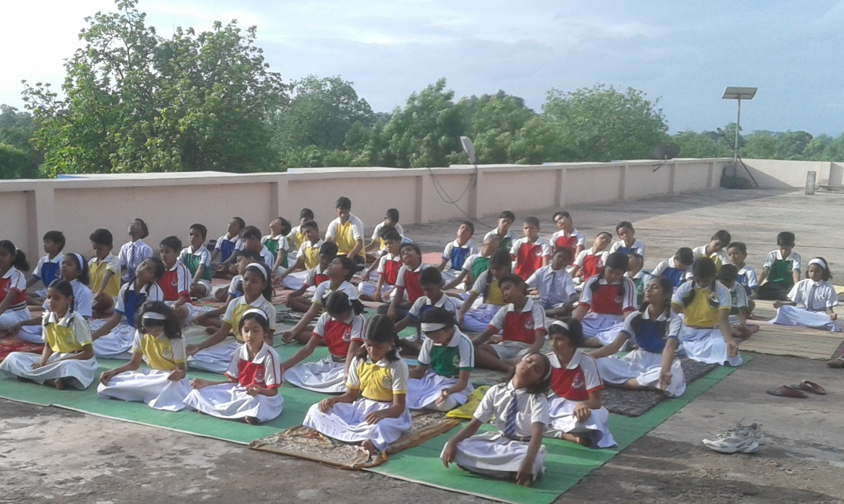
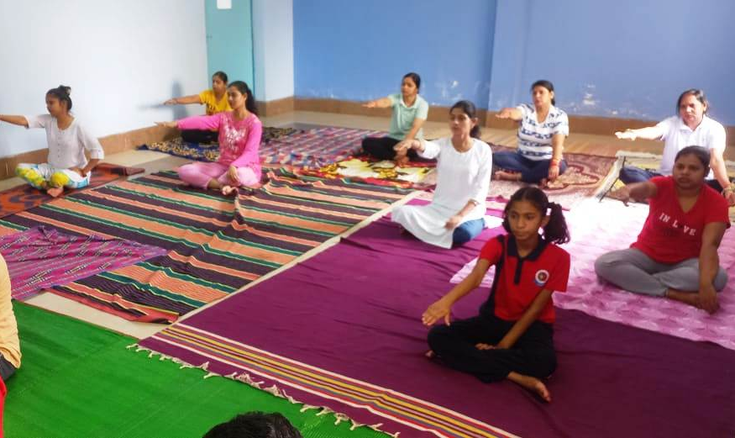
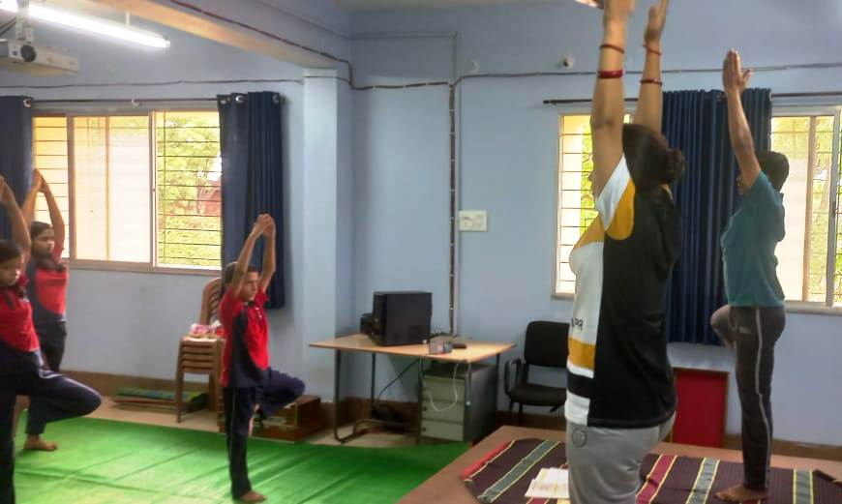
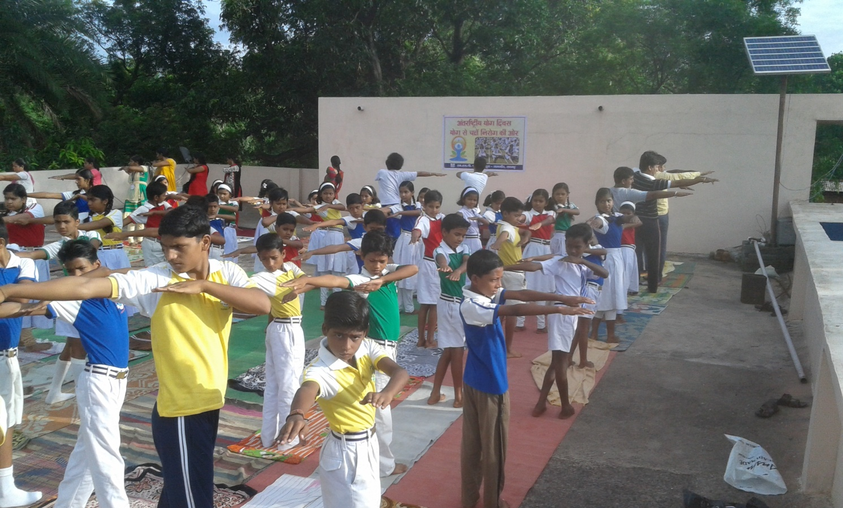
JUNE - 2023
INTERNATIONAL
YOGA DAY
19 - School Re-opens after Summer Vacation for classes KG to X.
21 - International Yoga Day (Celebration at School)
24 - Quiz competition (Science club)
29 - Eid-ul-Zuha (Bakrid)
SUN | MON | TUE | WED | THU | FRI | SAT
 |  |  |  | 1 | 2 | 3
4 | 5 | 6 | 7 | 8 | 9 | 10
11 | 12 | 13 | 14 | 15 | 16 | 17
18 | 19 | 20 | 21 | 22 | 23 | 24
25 | 26 | 27 | 28 | 29 | 30
MSP PUBLIC SCHOOL

Slide 6
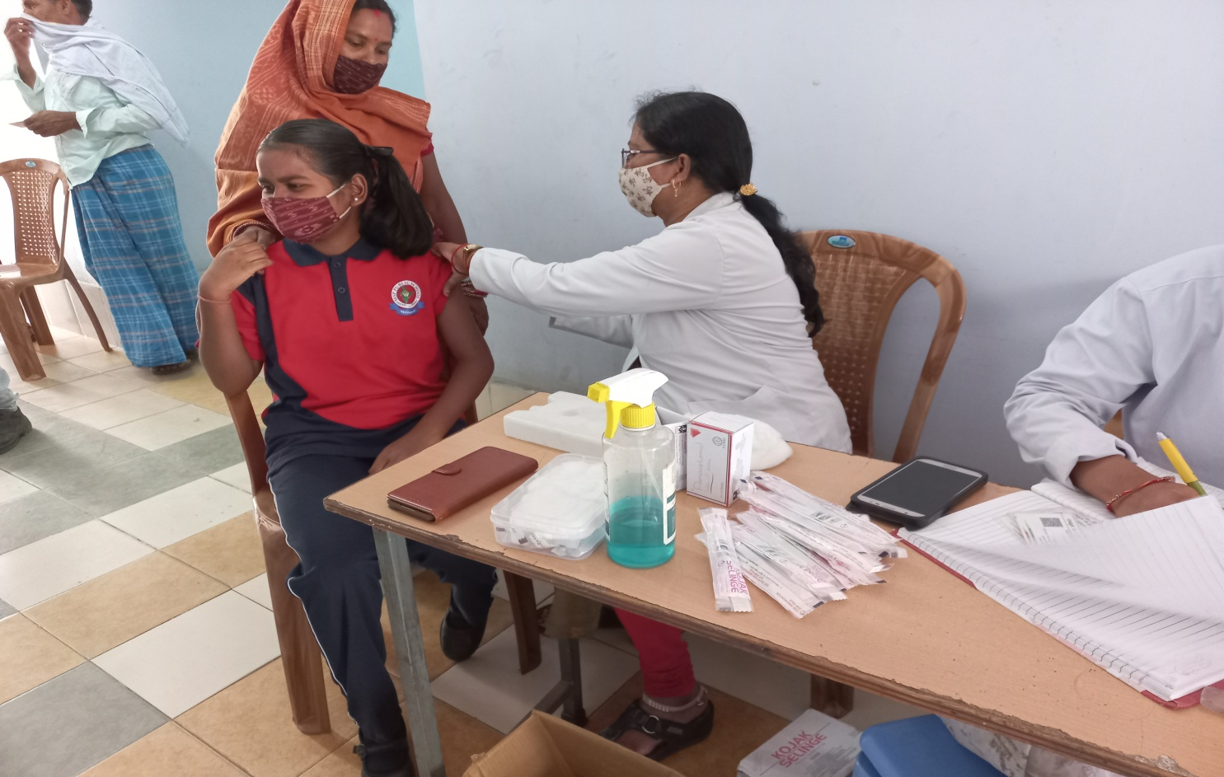
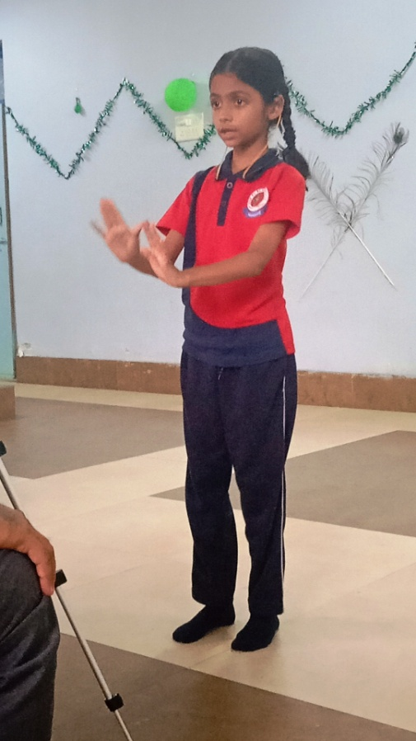
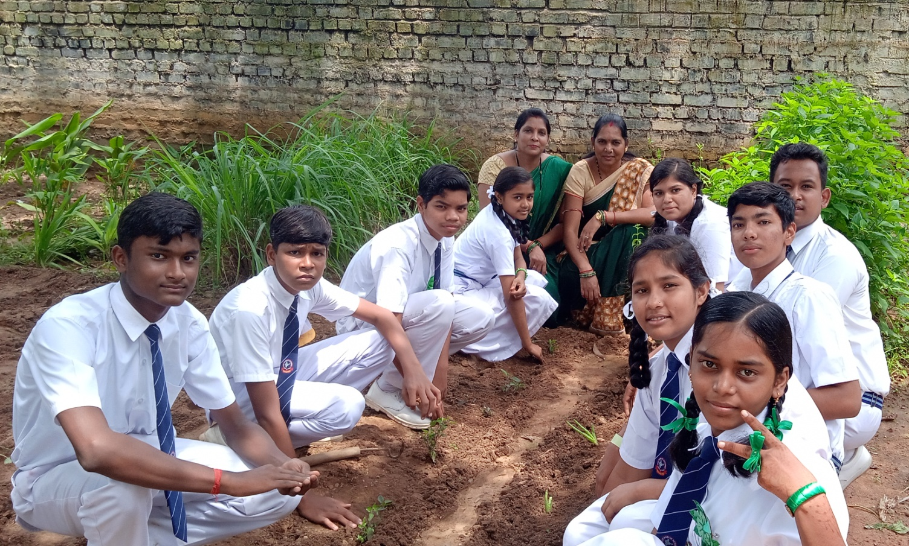
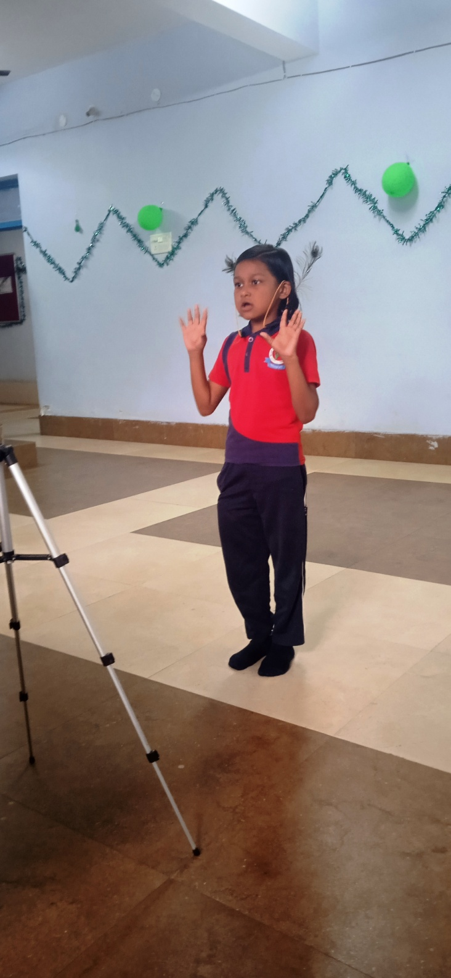
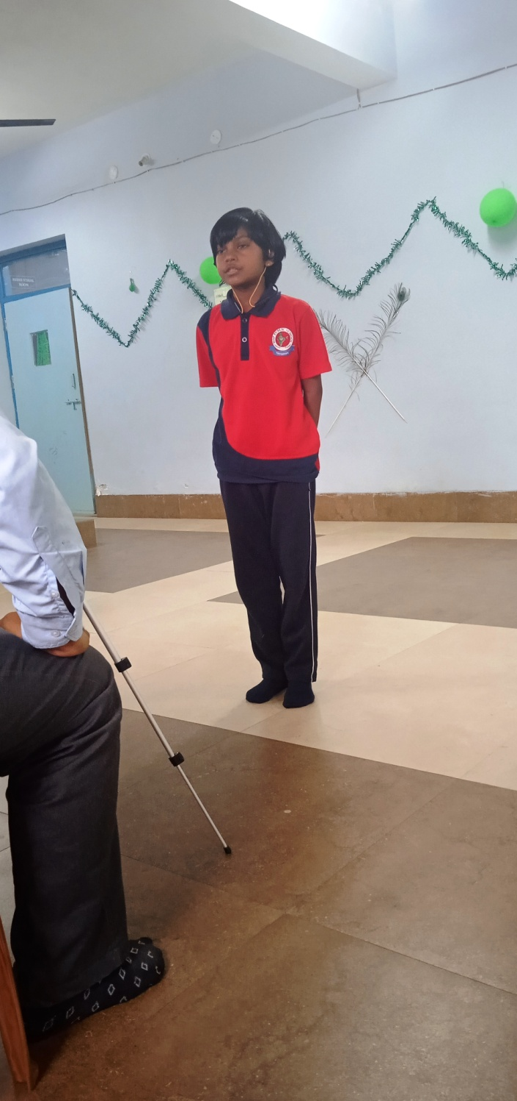
JULY - 2023
GREEN DAY
1 - Doctor's Day
(Wellness warrior).
3 - Guru Purnima,
Plastic Bag Free Day.
8 - Hindi Recitation
Competition.
11 -World's population Day.
15 -PT-I Begins (Class I to X) ,
Green Day Celebration
(Seedling by nature club)
17 - Hareli festival.
22 - National Parent's Day
Competition with parents
participation,
PT-I Concludes.
26 -Kargil Vijay Diwas.
28 -World Nature Conservation Day.
29 - Muharram.
31 - Munshi Premchand
Janmdiwas,
PTM for Class KG.
RECITATION
DOCTOR’S DAY.
SUN | MON | TUE | WED | THU | FRI | SAT
 |  |  |  |  |  | 1
2 | 3 | 4 | 5 | 6 | 7 | 8
9 | 10 | 11 | 12 | 13 | 14 | 15
16 | 17 | 18 | 19 | 20 | 21 | 22
23 | 24 | 25 | 26 | 27 | 28 | 29
30 | 31
MSP PUBLIC SCHOOL

Slide 7
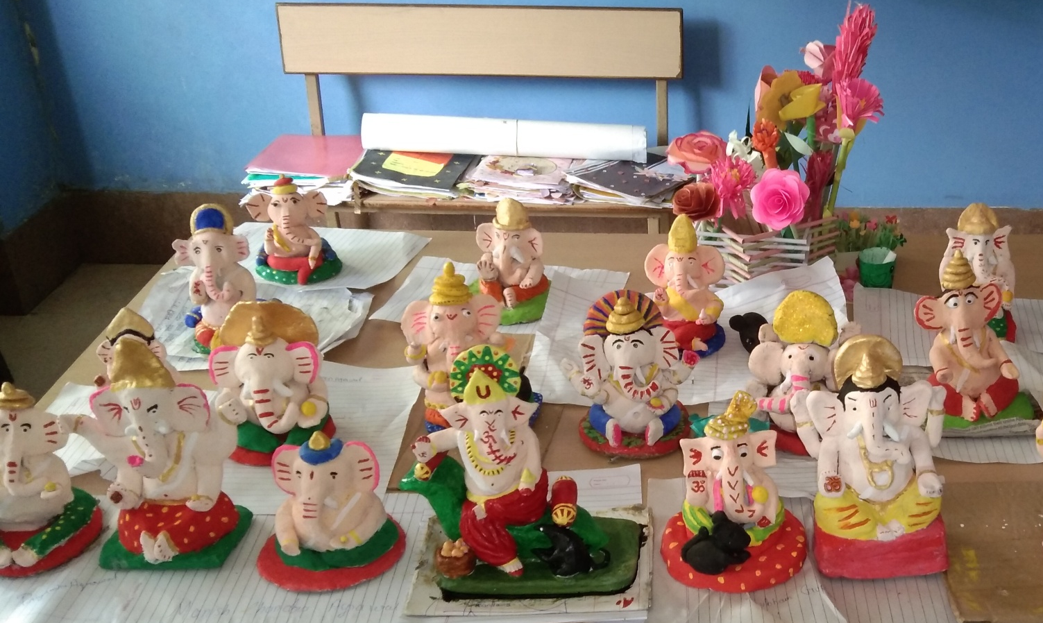
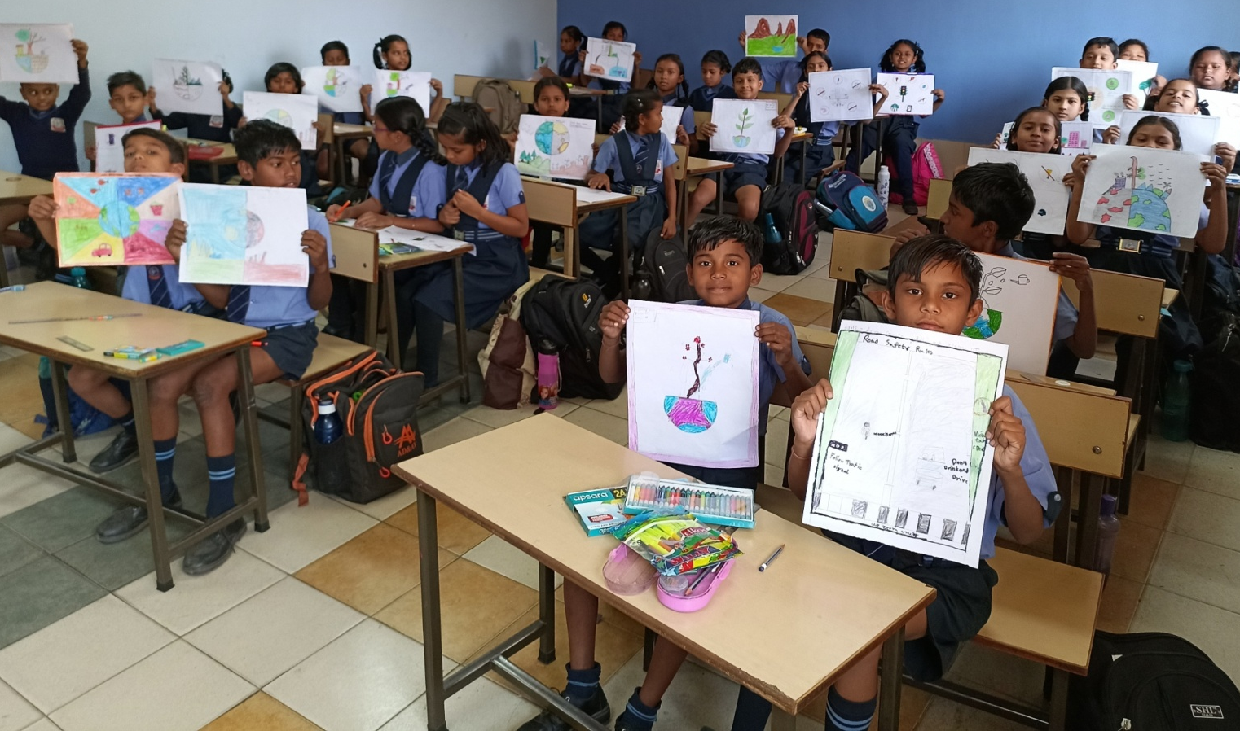
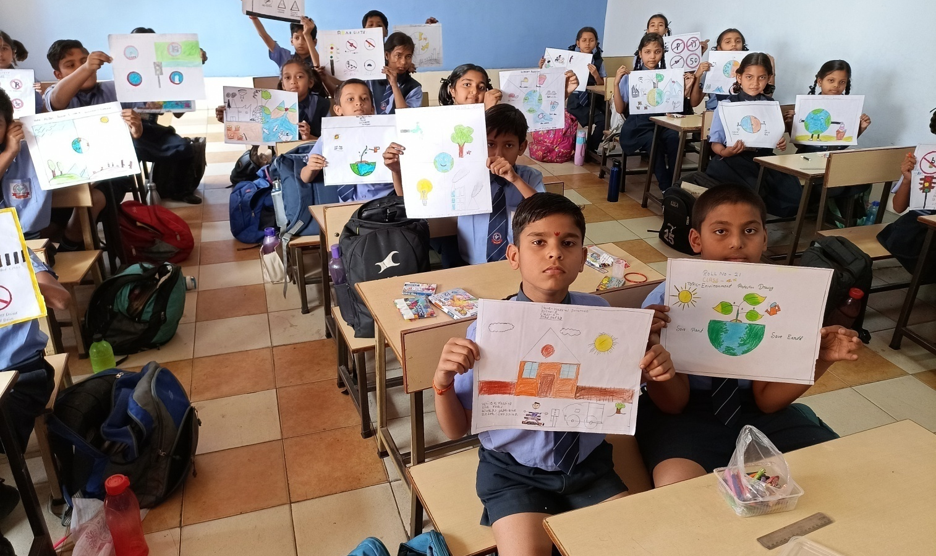

AUGUST - 2023
5 - PTM for Classes I to X.
7 - World Friendship Day card making.
9 - Vishva Aadiwasi Diwas.
12 - Art & Craft activity related to Independence Day.
15 - Independence Day.
21 - ASL begins for
Classes VI to X.
26 - Rakhi making.
29 - National Sports Day.
30 - Raksha Bandhan.
31 - PTM for Class KG.
ART & CRAFT
SUN | MON | TUE | WED | THU | FRI | SAT
 |  | 1 | 2 | 3 | 4 | 5
6 | 7 | 8 | 9 | 10 | 11 | 12
13 | 14 | 15 | 16 | 17 | 18 | 19
20 | 21 | 22 | 23 | 24 | 25 | 26
27 | 28 | 29 | 30 | 31
MSP PUBLIC SCHOOL

Slide 8
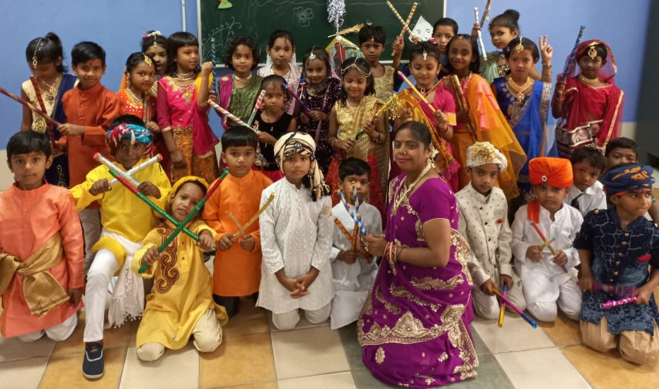
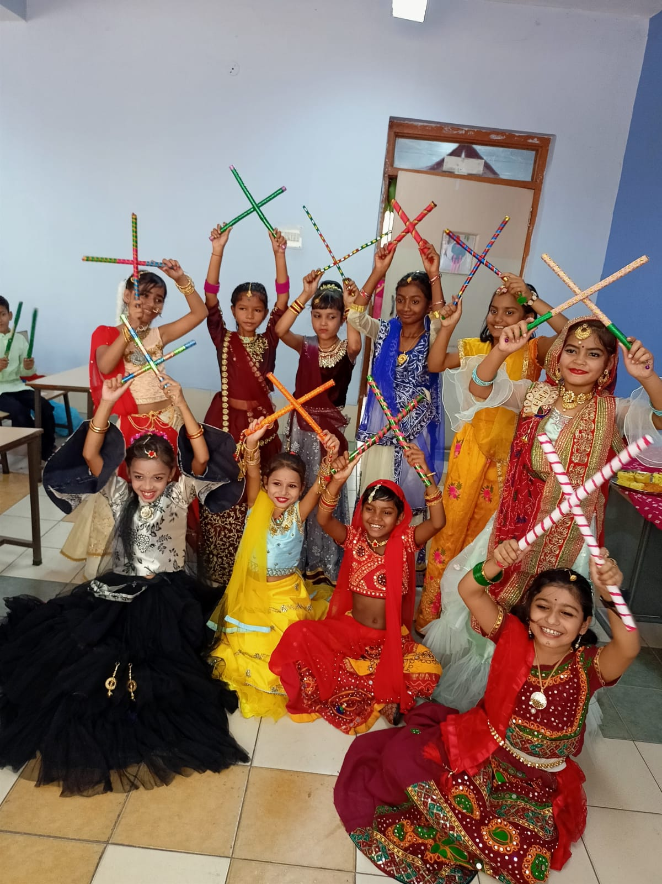
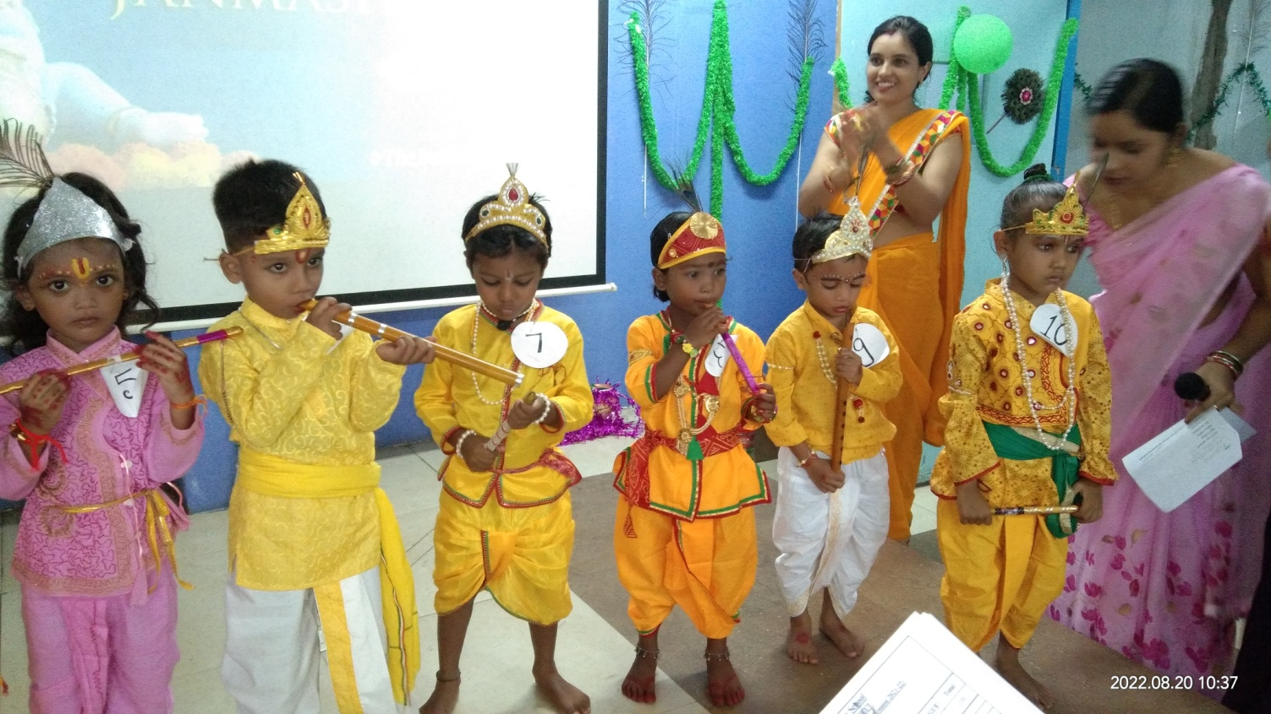
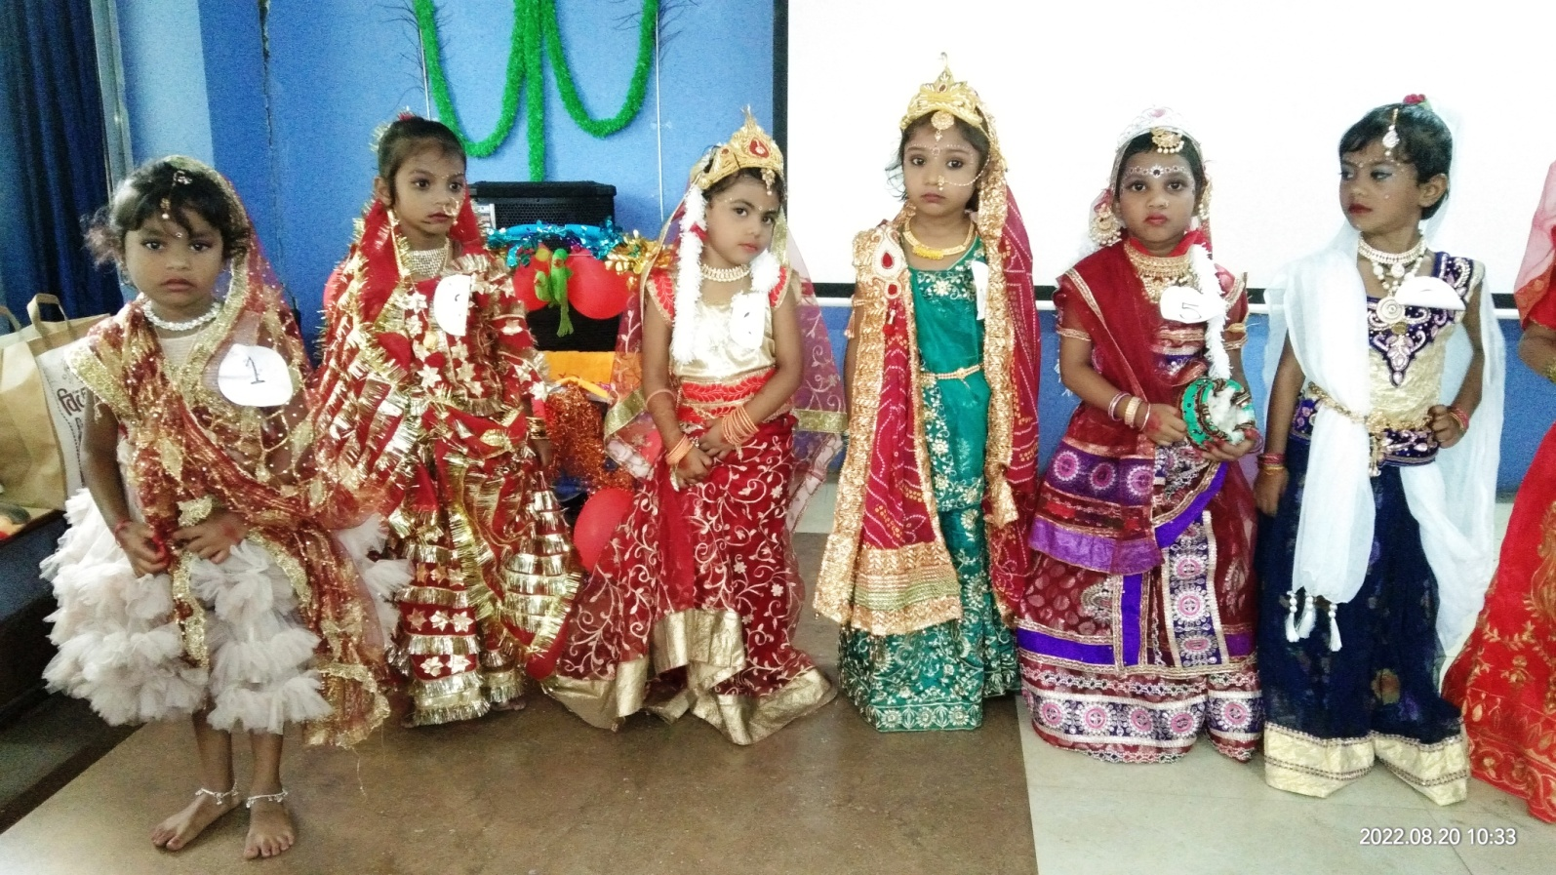
SEPTEMBER- 2023
1 - Revision begins for Classes KG to X.
2 - Fancy Dress Competition.
4 - Copy Sealing begins
5 - Teachers Day Celebration.
6 - Janmashtami
8 - World's Literacy Day.
9 - Making of Eco-friendly
Idol Ganesha , ASL Concludes.
14 - Hindi Divas.
16 - Coloring of Idol Ganesha, Revision concludes.
18 - Teeja
19 - Ganesh Chaturthi .
20 - Nawa-Khai.
21 - HY Exam begins, classes I to X & 1st Term of KG.
28 - Eid-E-Milad
JANMASTAMI
CELEBRATION
SUN | MON | TUE | WED | THU | FRI | SAT
 |  |  |  |  | 1 | 2
3 | 4 | 5 | 6 | 7 | 8 | 9
10 | 11 | 12 | 13 | 14 | 15 | 16
17 | 18 | 19 | 20 | 21 | 22 | 23
24 | 25 | 26 | 27 | 28 | 29 | 30
MSP PUBLIC SCHOOL

Slide 9
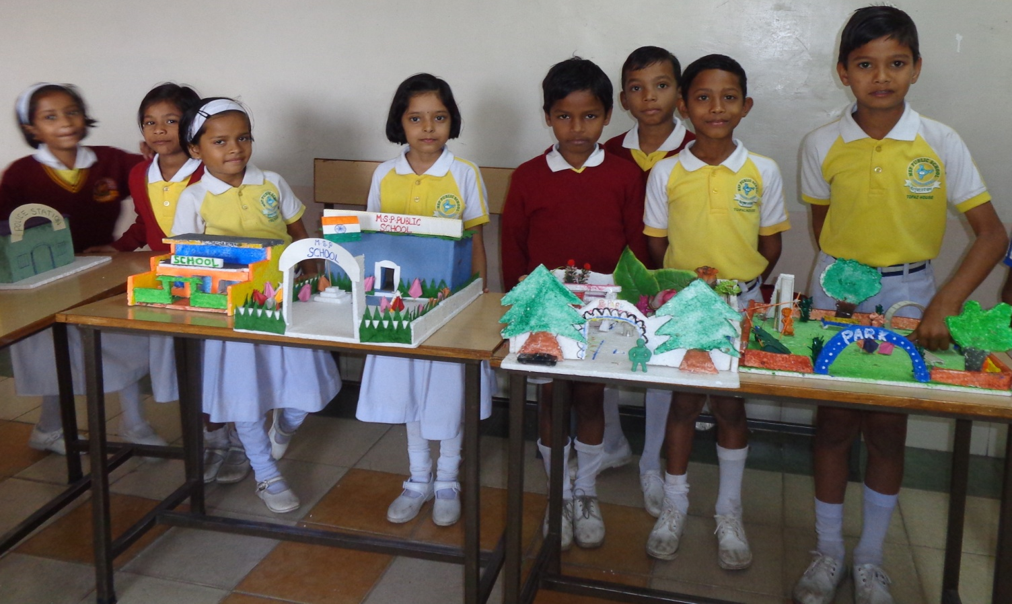
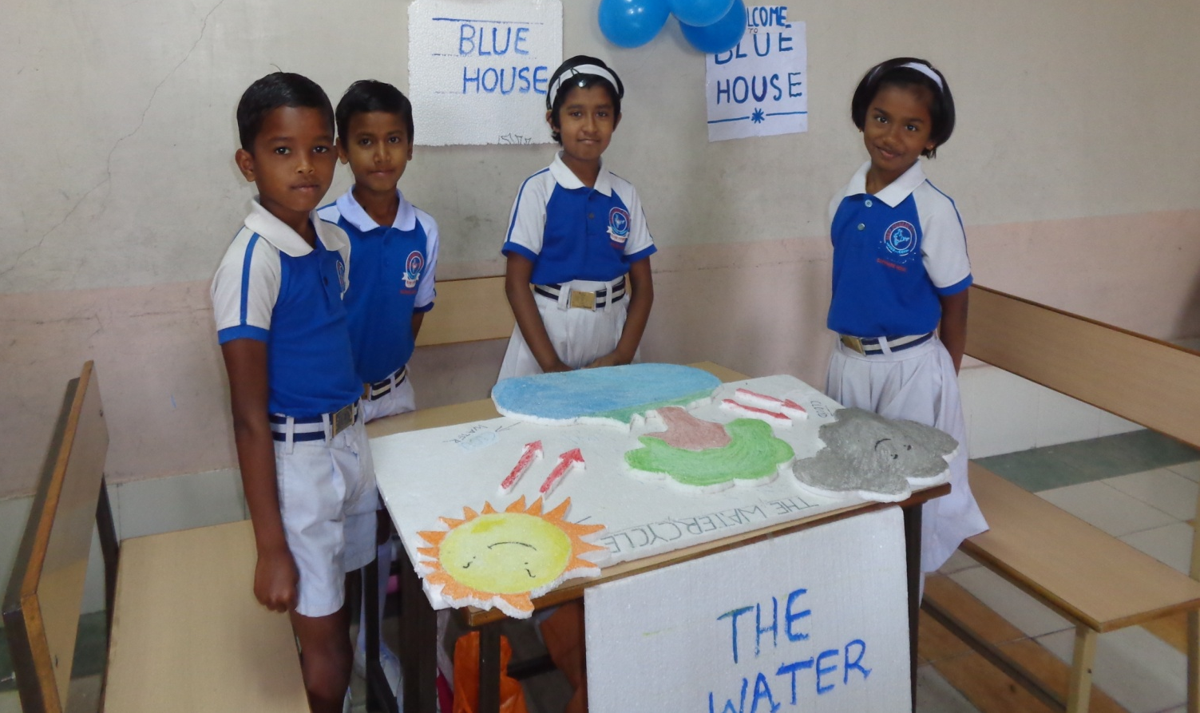
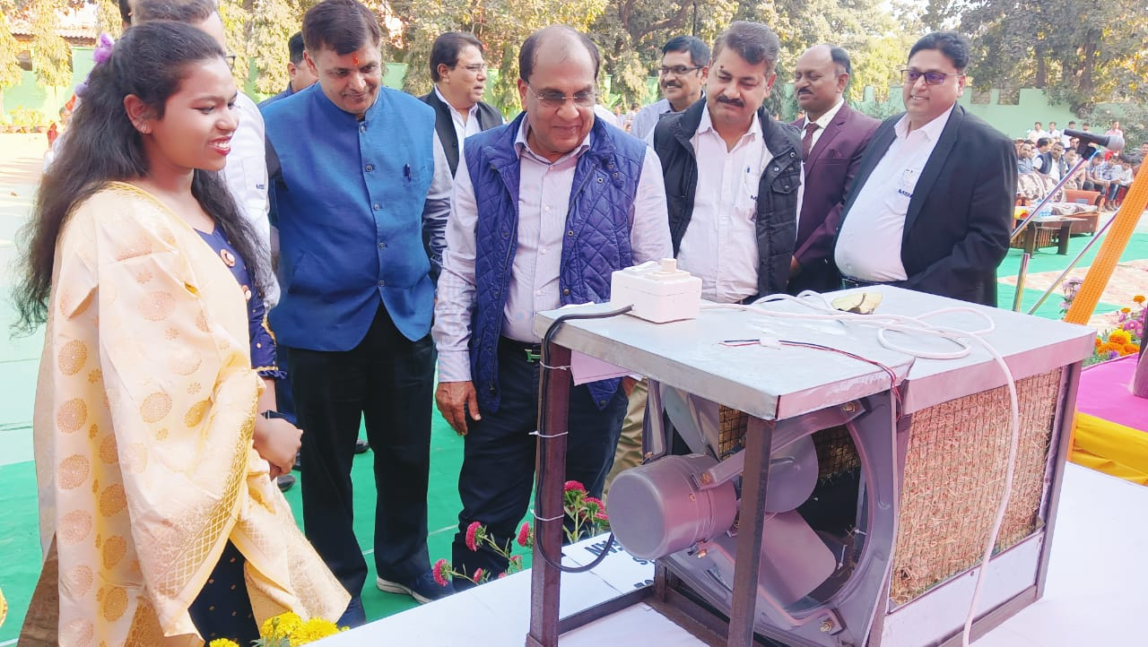
OCTOBER - 2023
2 - Gandhi Jayanti & Shastri Jayanti
4 - Animal Welfare Day.
7 - Half yearly exam conclude.
10 – IGKO (SOF)
14 - Science Exhibition.
16 - World Food Day.
19 - PTM & Result Declaration of Ist Term .
20 - Dussehra Break begins.
27 - School re-opens after Dussehra Break.
SCIENCE EXHIBITION
INSPIRE AWARDS WINNER
SUN | MON | TUE | WED | THU | FRI | SAT
1 | 2 | 3 | 4 | 5 | 6 | 7
8 | 9 | 10 | 11 | 12 | 13 | 14
15 | 16 | 17 | 18 | 19 | 20 | 21
22 | 23 | 24 | 25 | 26 | 27 | 28
29 | 30 | 31
MSP PUBLIC SCHOOL

Slide 10
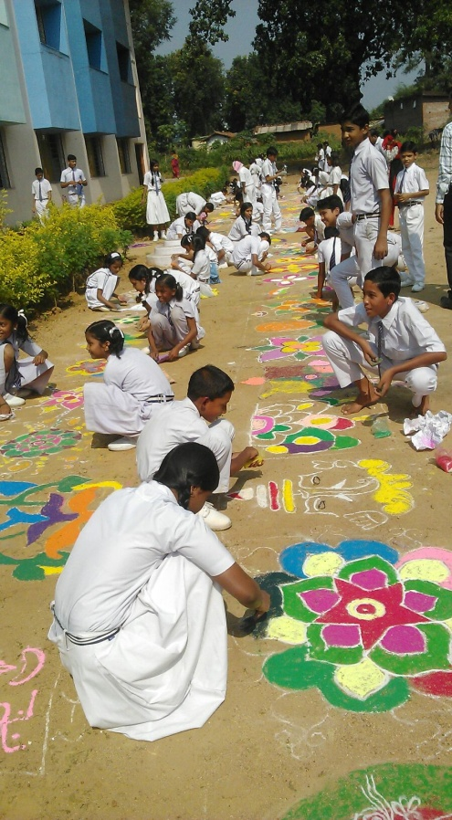
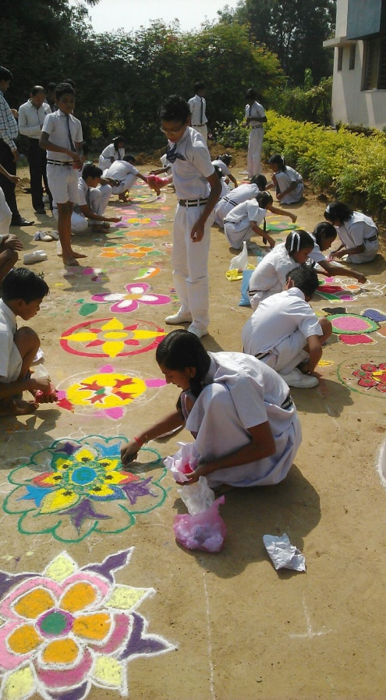
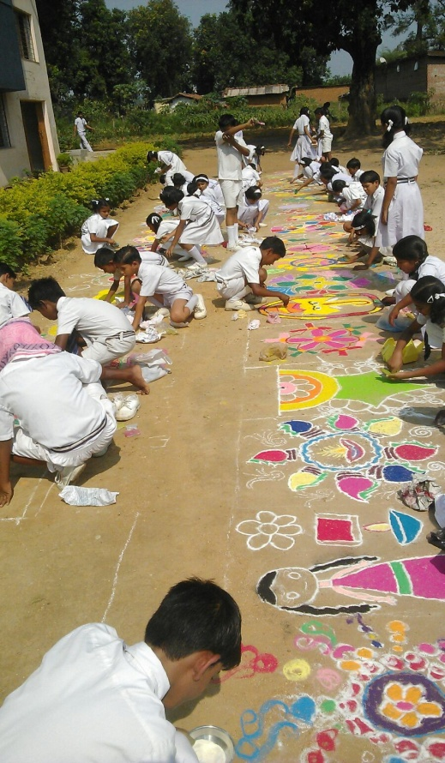
NOVEMBER - 2023
1 - C.G Foundation Day.
2 – IEO (SOF)
4 - Rangoli, Diya and Pot decoration activity.
10 - Diwali break begins
14 - Children's Day & Bhai Duj.
16 - School reopens after Diwali break.
18 - Compost Making
Activity
25 - English Recitation.
27 - Guru Nanak Jayanti
30 – IMO (SOF)
Rangoli Competition
SUN | MON | TUE | WED | THU | FRI | SAT
 |  |  | 1 | 2 | 3 | 4
5 | 6 | 7 | 8 | 9 | 10 | 11
12 | 13 | 14 | 15 | 16 | 17 | 18
19 | 20 | 21 | 22 | 23 | 24 | 25
26 | 27 | 28 | 29 | 30
MSP PUBLIC SCHOOL

Slide 11
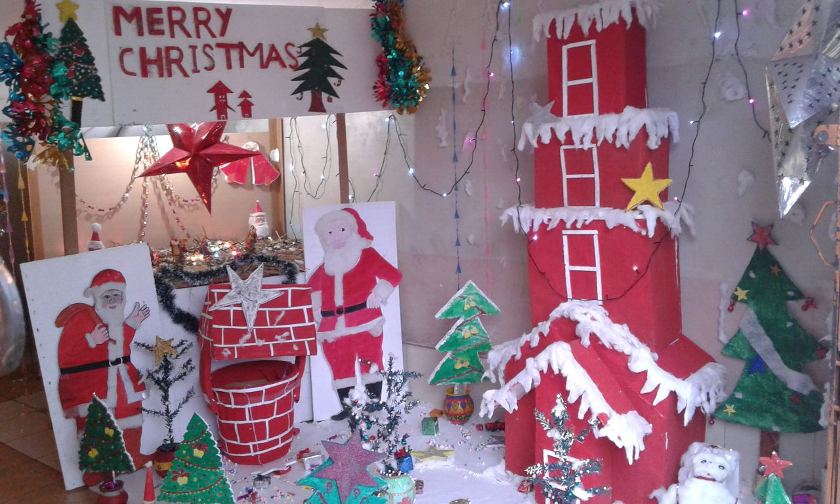
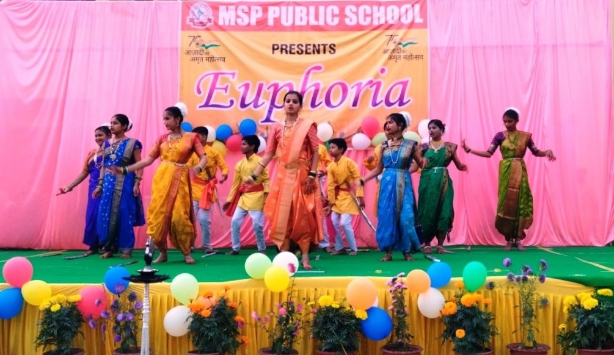
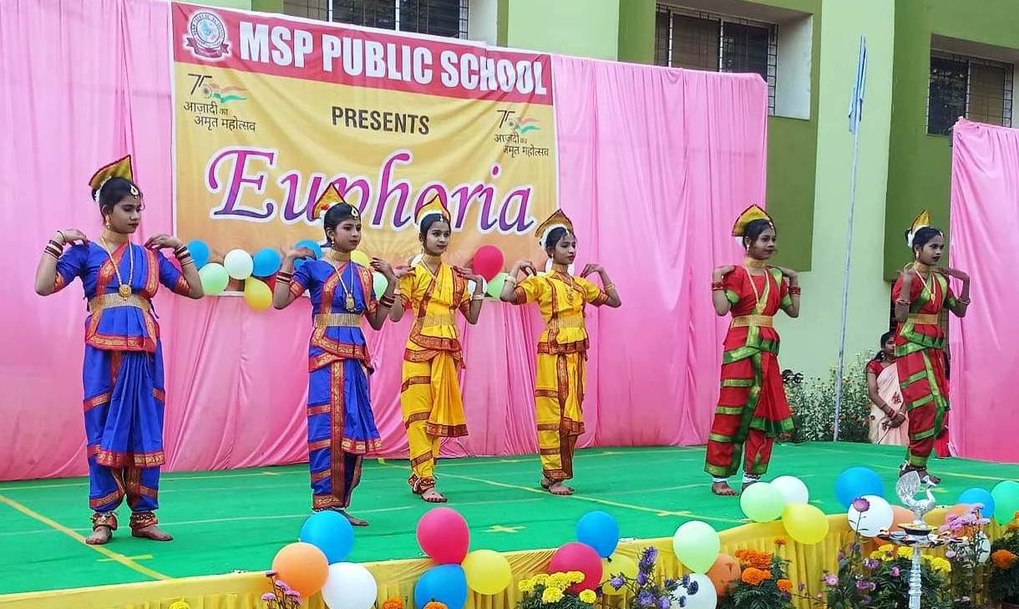
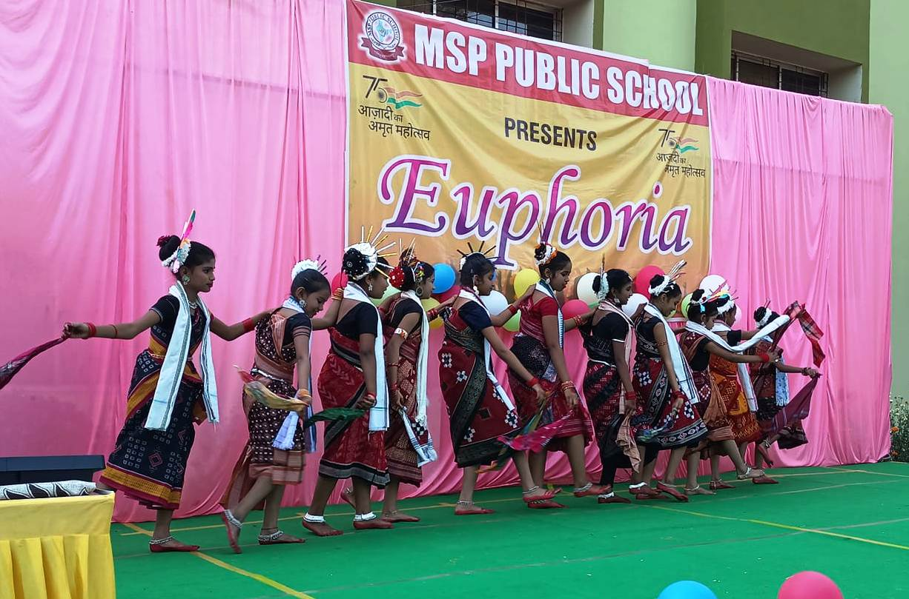
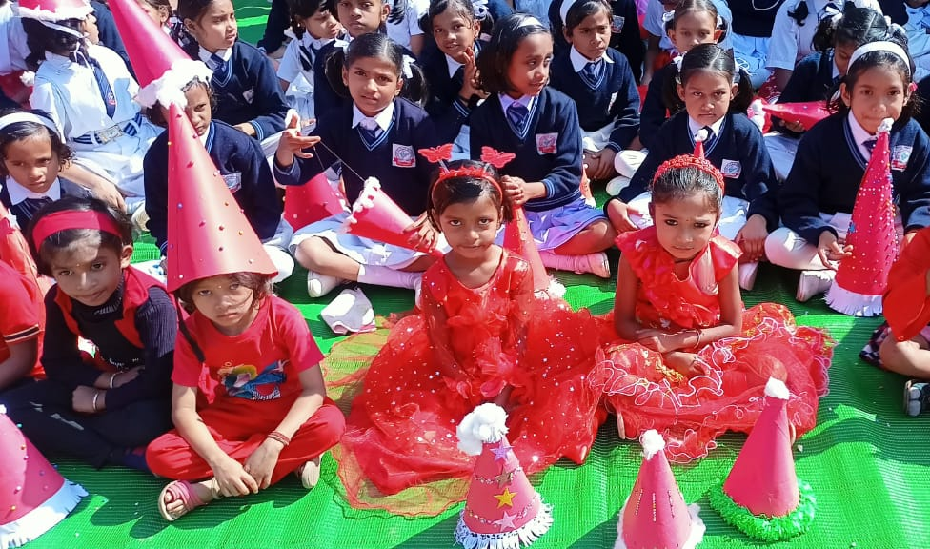
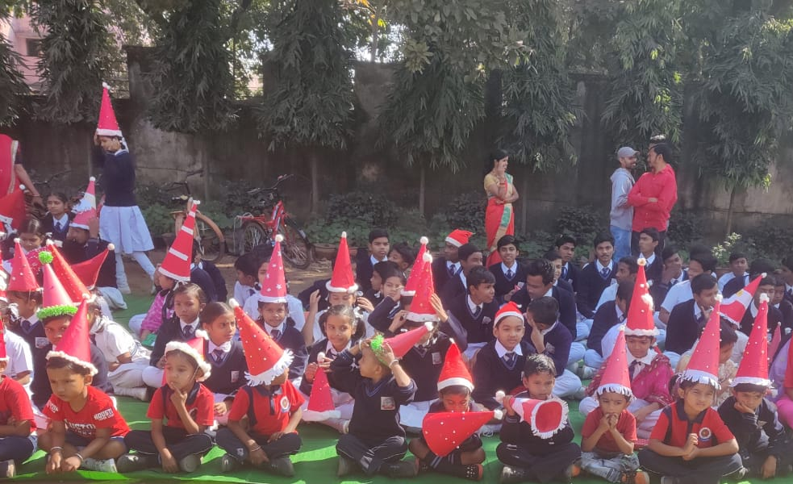
DECEMBER - 2023
Merry Christmas
2 - PTM for KG,
National Pollution Day (Drawing Competition)
5 – NSO (SOF)
11 - PT-II begins for class X
16 - PT-II concludes.
18 - Guru Ghasidas Jayanti
19 – NCO (SOF)
23 - Annual Function.
25 - Christmas Day, Winter
break begins for classes
KG to X.
ANNUAL FUNCTION
SUN | MON | TUE | WED | THU | FRI | SAT
 |  |  |  |  | 1 | 2
3 | 4 | 5 | 6 | 7 | 8 | 9
10 | 11 | 12 | 13 | 14 | 15 | 16
17 | 18 | 19 | 20 | 21 | 22 | 23
24 | 25 | 26 | 27 | 28 | 29 | 30
31
MSP PUBLIC SCHOOL

Slide 12
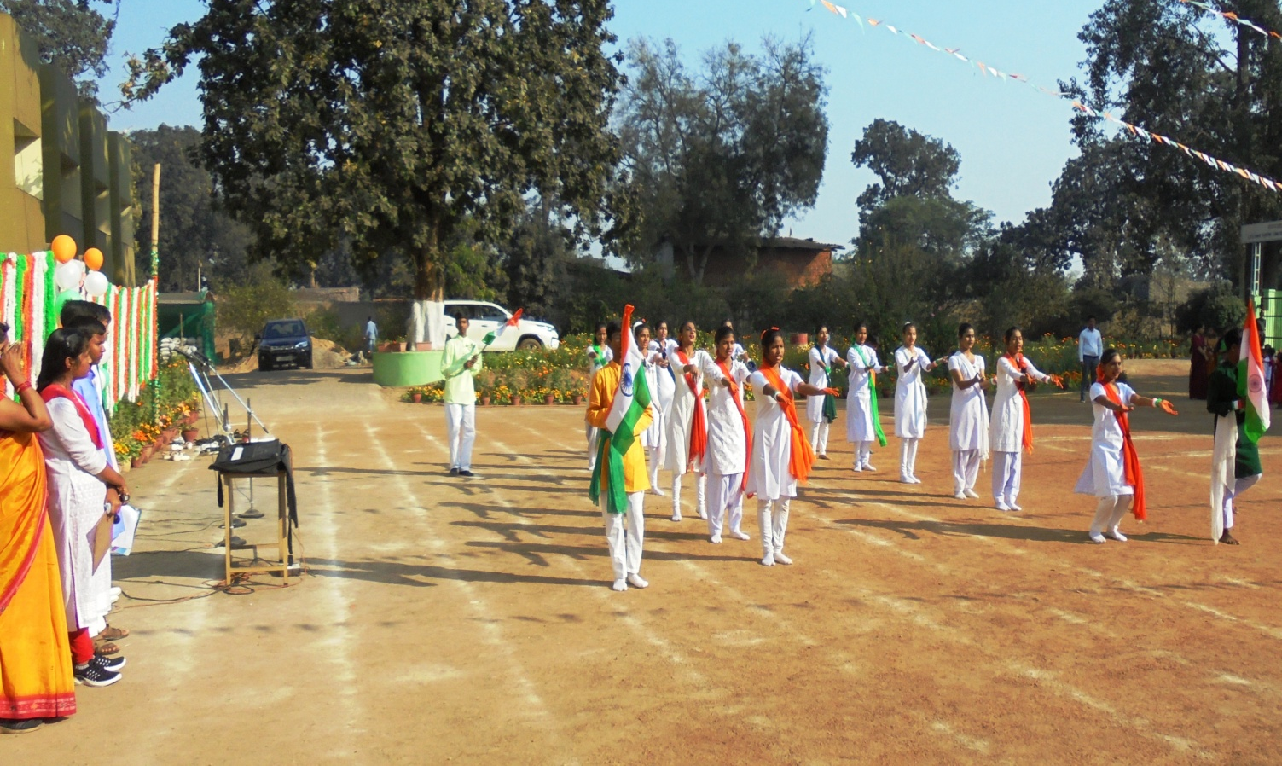
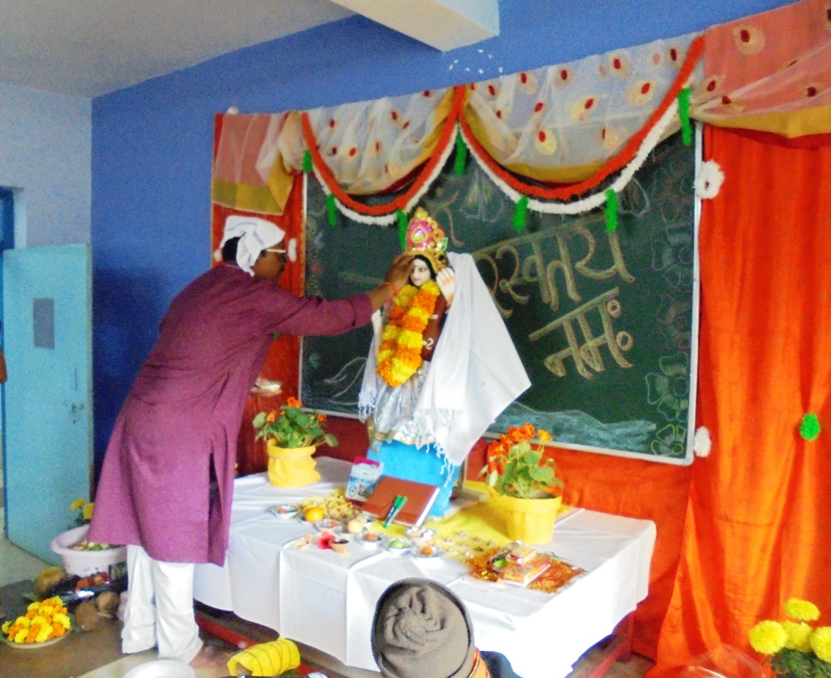
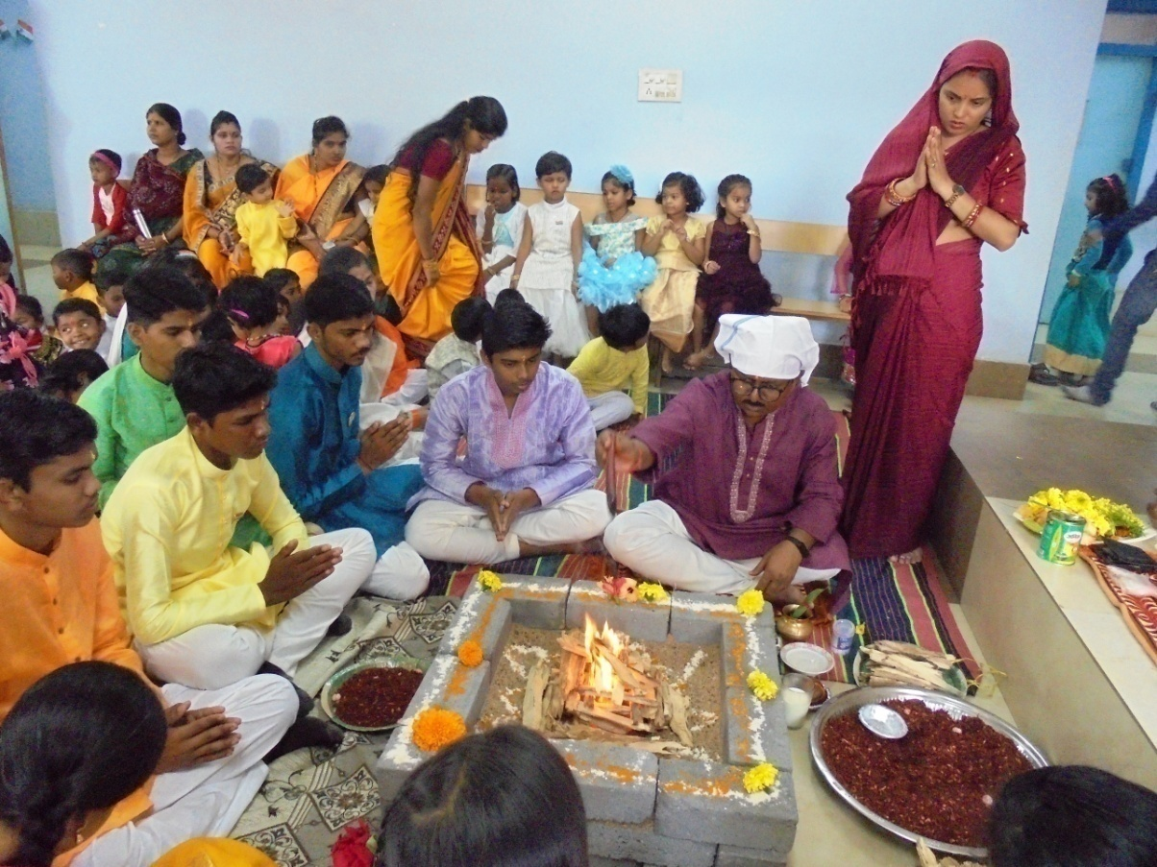
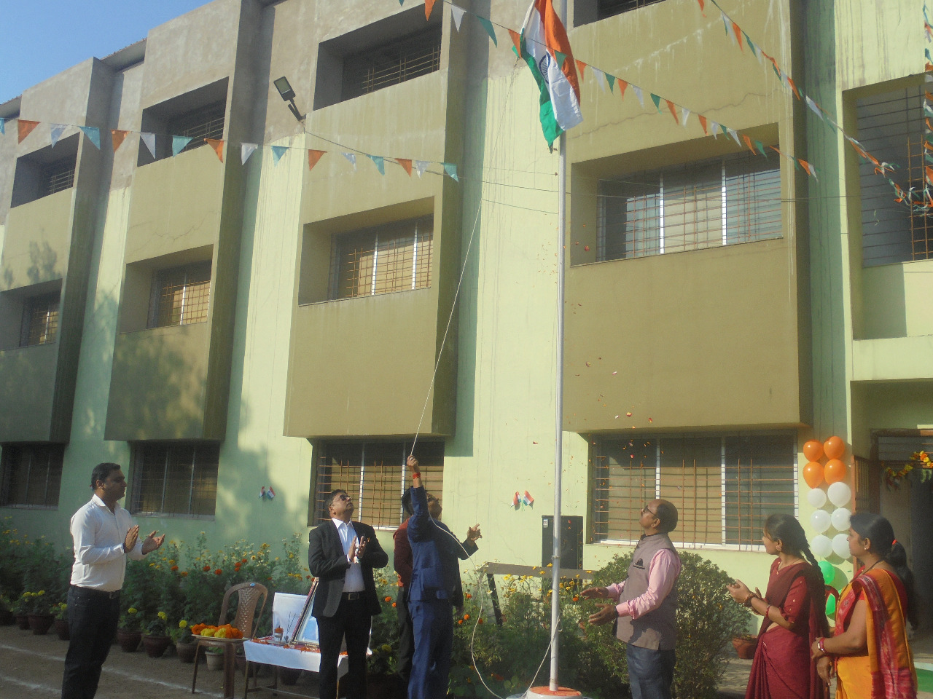
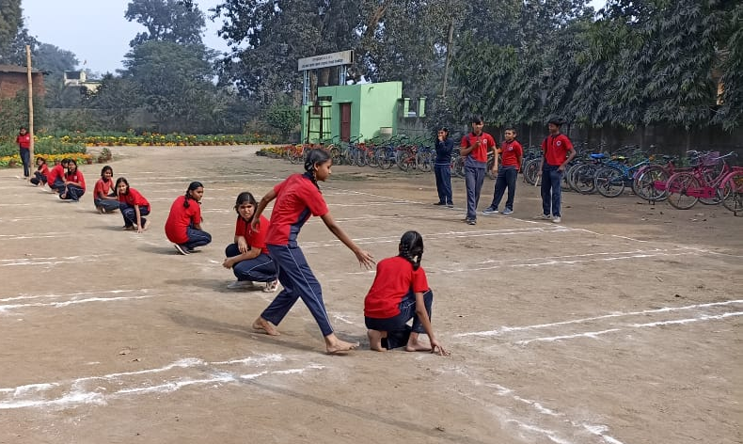
JANUARY - 2024
1 - New Year (School Holiday).
2 - School reopens for classes KG
to X.
8 - PT-II begins for classes I to IX,
Pre-board of class X.
12 - National Youth Day
13 - PT-II Concludes for
classes I to IX.
15 - Pongal & Makar Sankranti
16- ASL begins VI to X.
17 - Guru Govind Singh Jayanti.
20- Annual Sports Day,
Pre-board concludes
23 - Subhash Chandra Bose
Jayanti.
26 - Republic Day Celebration
27 – PTM for KG to X & Result Declaration of PT-II.
30 - Martyrs day.
Republic Day
SPORTS DAY
SUN | MON | TUE | WED | THU | FRI | SAT
 | 1 | 2 | 3 | 4 | 5 | 6
7 | 8 | 9 | 10 | 11 | 12 | 13
14 | 15 | 16 | 17 | 18 | 19 | 20
21 | 22 | 23 | 24 | 25 | 26 | 27
28 | 29 | 30 | 31
MSP PUBLIC SCHOOL

Slide 13
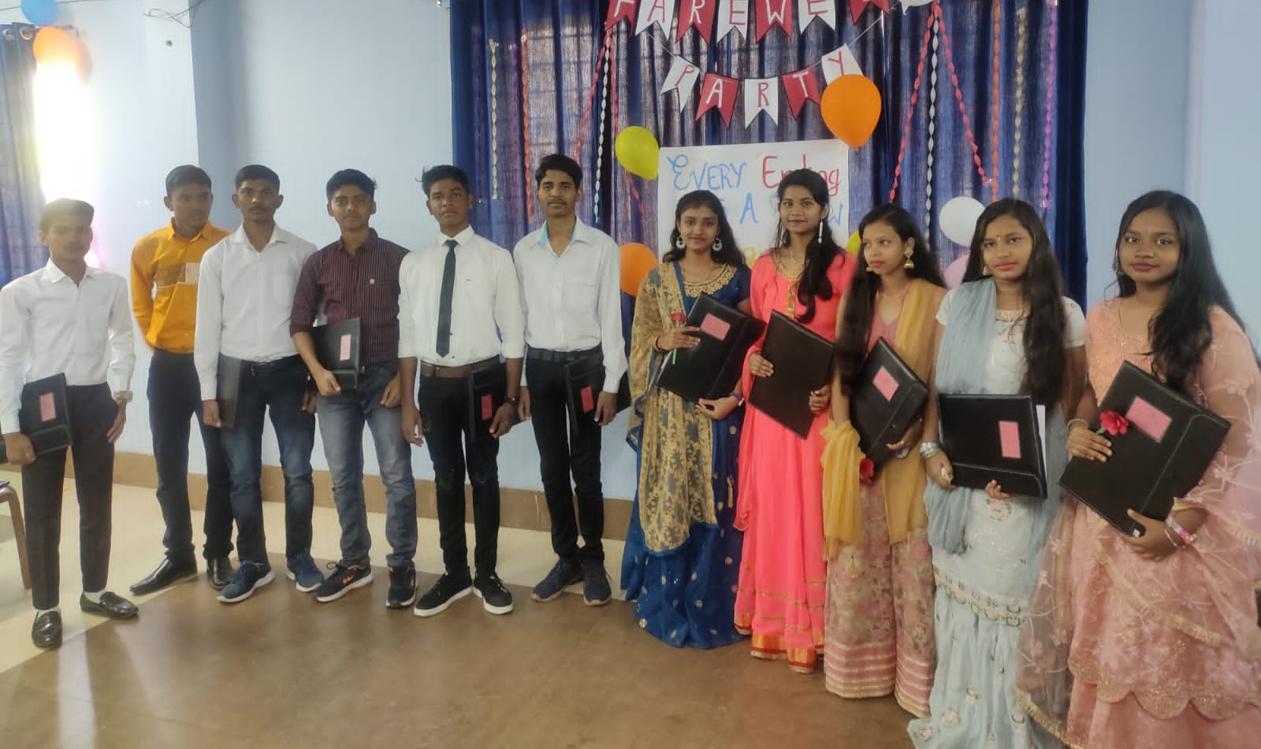
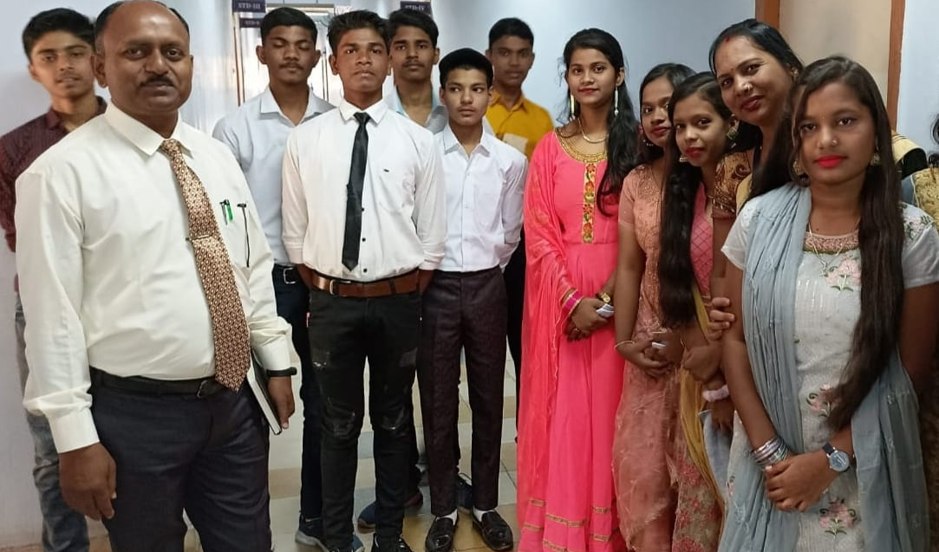
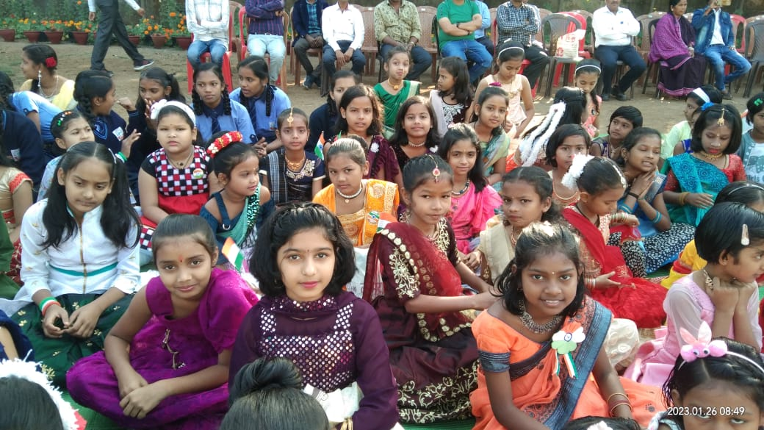
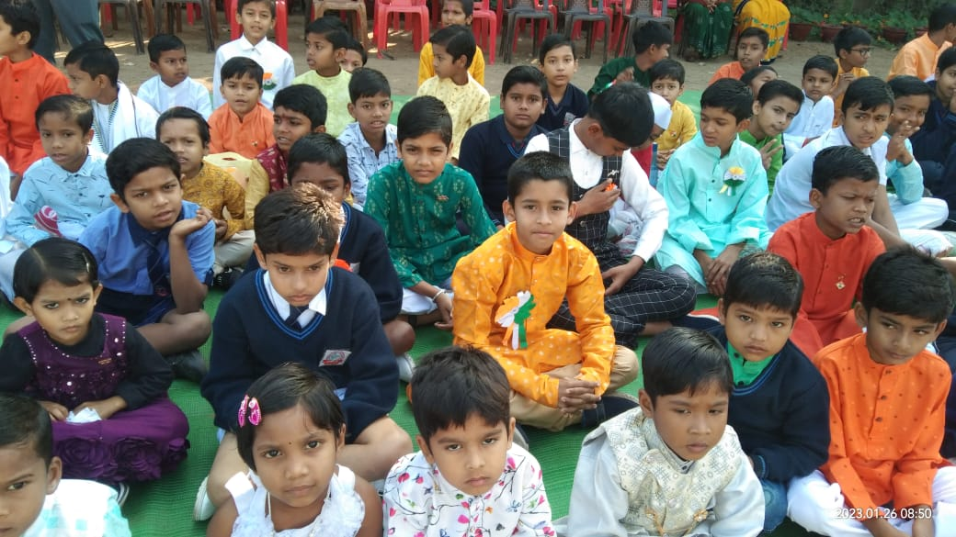
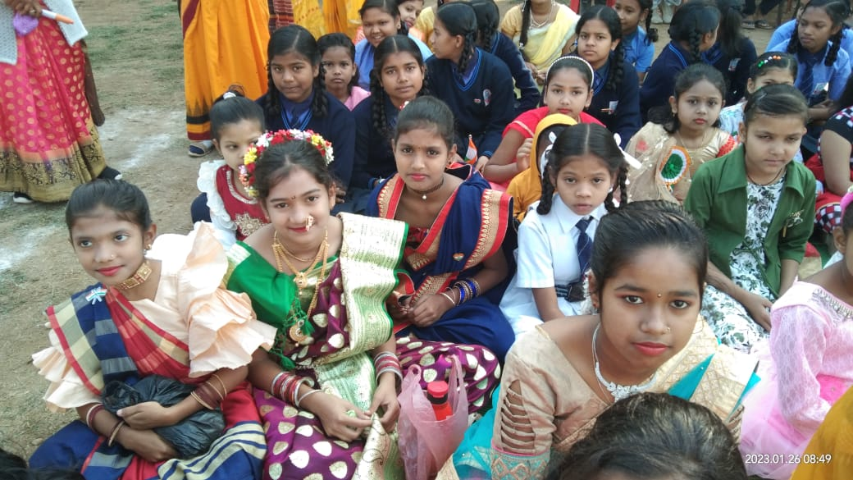
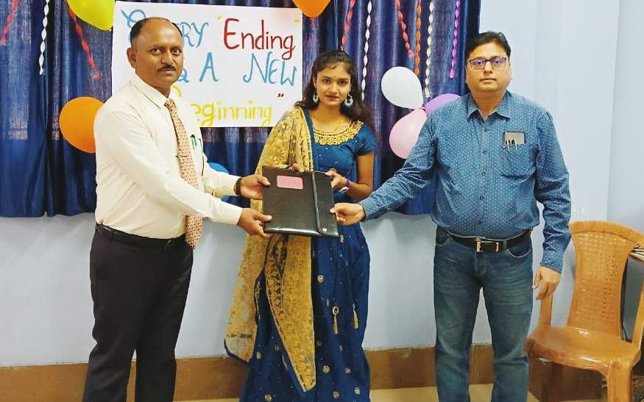
FEBRUARY - 2024
2 - ASL concludes
3 - Maths Quiz.
10 - Group discussion
in Hindi
14 - Basant Panchami
Celebration
15 - Revision begins for classes KG to IX
19 - Copy Sealing begins
29 - PTM for KG ,
Revision concludes
FAREWELL
SUN | MON | TUE | WED | THU | FRI | SAT
 |  |  |  | 1 | 2 | 3
4 | 5 | 6 | 7 | 8 | 9 | 10
11 | 12 | 13 | 14 | 15 | 16 | 17
18 | 19 | 20 | 21 | 22 | 23 | 24
25 | 26 | 27 | 28 | 29
MSP PUBLIC SCHOOL

Slide 14
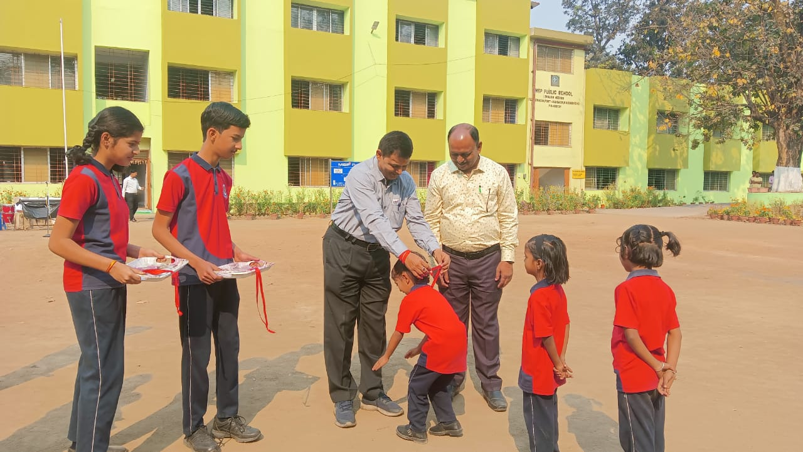
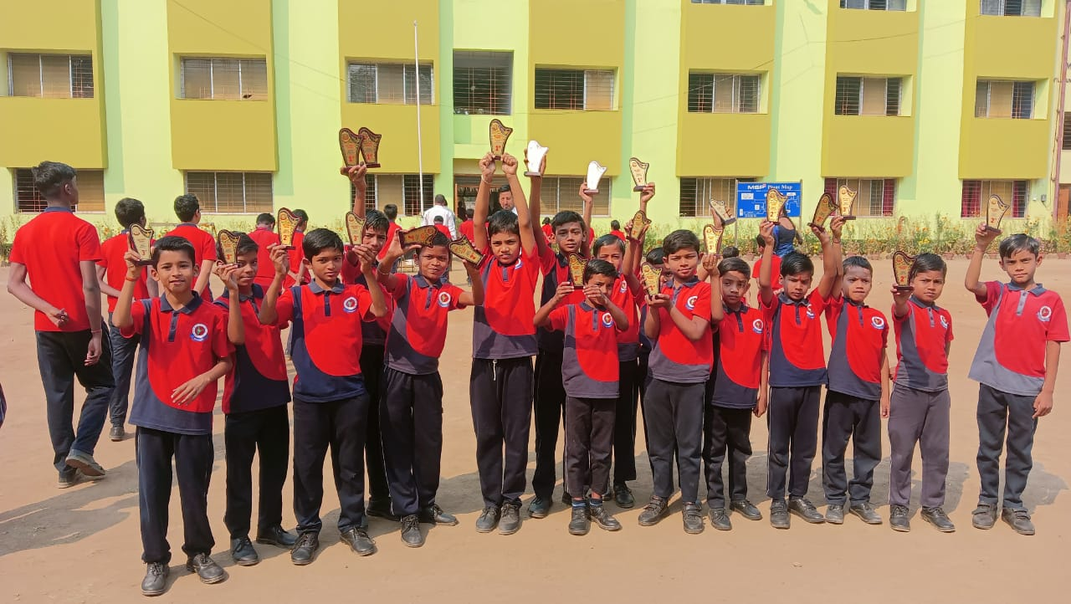


MARCH - 2024
1 - Annual Exam begins for classes I to IX, Term II begins for KG.
8 – Mahashivaratri
15 - Annual Exam Concludes.
24 - Holika Dahan.
25 - Holi.
29 - Good Friday.
30 - Annual Result Declaration
PRIZE DISTRIBUTION
Academic Session: 2023-24 Concludes
SUN | MON | TUE | WED | THU | FRI | SAT
 |  |  |  |  | 1 | 2
3 | 4 | 5 | 6 | 7 | 8 | 9
10 | 11 | 12 | 13 | 14 | 15 | 16
17 | 18 | 19 | 20 | 21 | 22 | 23
24 | 25 | 26 | 27 | 28 | 29 | 30
31
MSP PUBLIC SCHOOL

