Slide 2
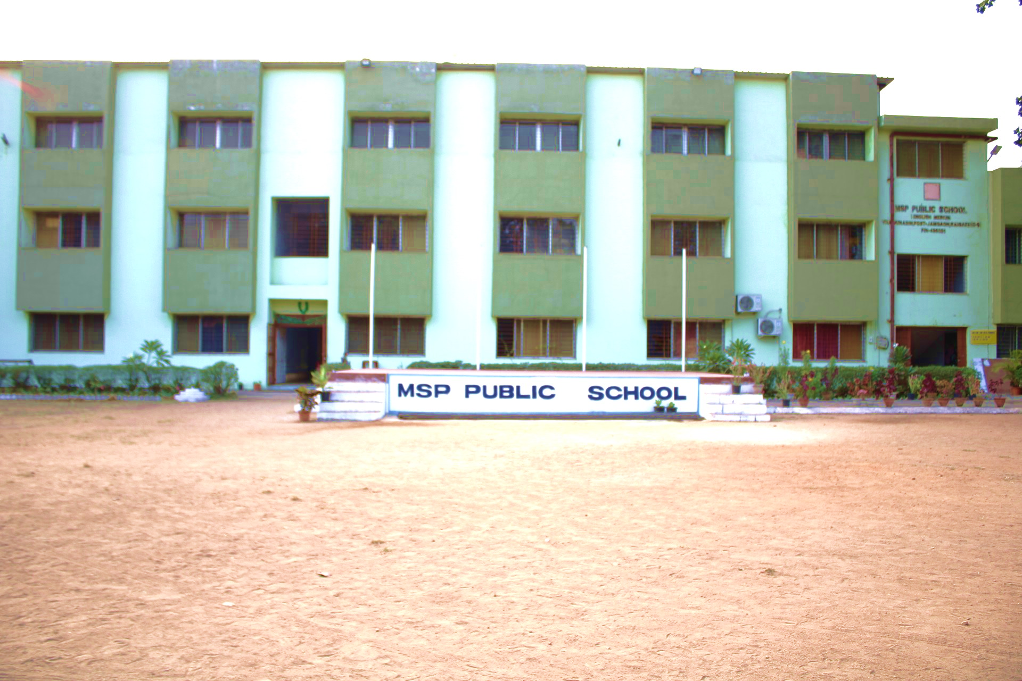
ANNUAL CALENDAR 2025-26
MSP PUBLIC SCHOOL
Red- School Holiday
Green- Examinations
Blue- Activity
Purple- PTM

Slide 3
APRIL - 2025
1- New Session Begins
4- Vidya Aarambh
6- Ram Navami
10- Mahavir Jayanti
14- Ambedkar Jayanti
18- Good Friday
VIDYA AARAMBH
Note- The details given above are tentative only. Changes may happened due to unavoidable circumstances.
SUN | MON | TUE | WED | THU | FRI | SAT
 |  | 1 | 2 | 3 | 4 | 5
6 | 7 | 8 | 9 | 10 | 11 | 12
13 | 14 | 15 | 16 | 17 | 18 | 19
20 | 21 | 22 | 23 | 24 | 25 | 26
27 | 28 | 29 | 30
MSP PUBLIC SCHOOL

Slide 4
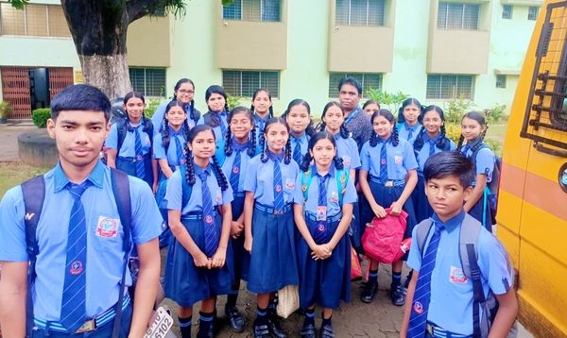
MAY - 2025
1- Summer Vacation begins for KG to V
8- World Red Cross Day
12- Buddha Purnima
12- Summer Vacation begins for Class VI to X
SUMMER VACATION
Note- The details given above are tentative only. Changes may happened due to unavoidable circumstances.
SUN | MON | TUE | WED | THU | FRI | SAT
 |  |  |  | 1 | 2 | 3
4 | 5 | 6 | 7 | 8 | 9 | 10
11 | 12 | 13 | 14 | 15 | 16 | 17
18 | 19 | 20 | 21 | 22 | 23 | 24
25 | 26 | 27 | 28 | 29 | 30 | 31
MSP PUBLIC SCHOOL

Slide 5
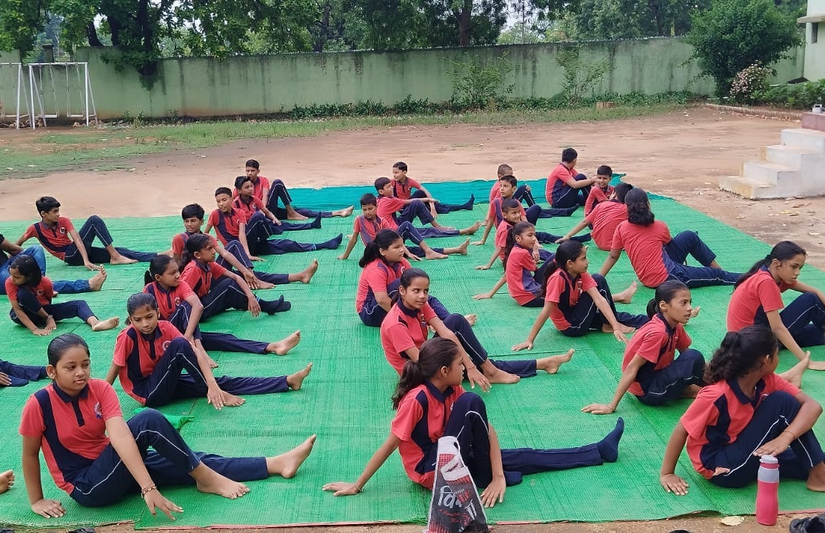
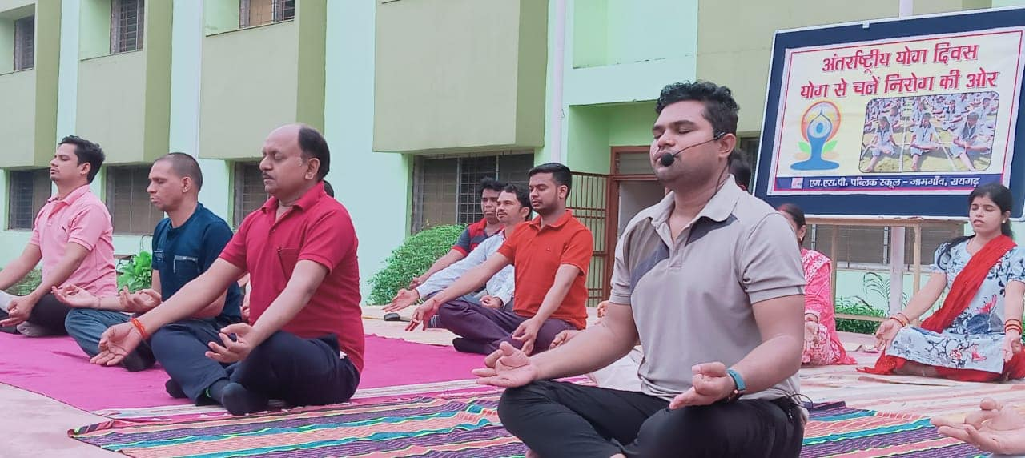
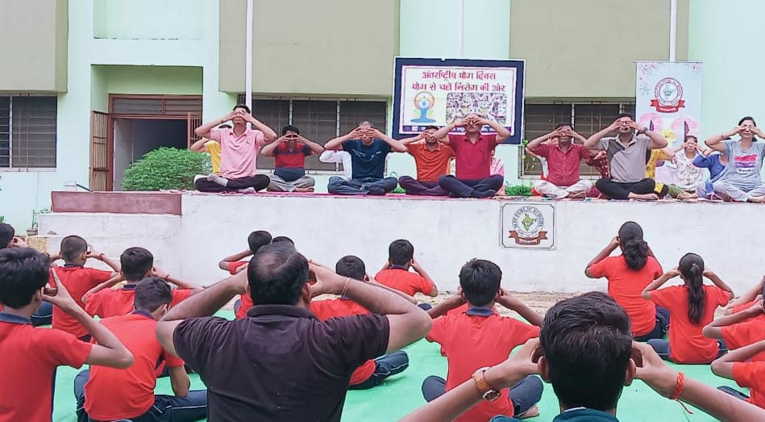
JUNE - 2025
INTERNATIONAL YOGA DAY
7- Eid ul-Adha
11- Kabir Jayanti
16- School Re-opens after Summer Vacation for Classes KG to X
21- International Yoga Day (Celebration at School)
27- Rath Yatra
28 – Plant Recognition (Class I to V) / Compost Making (Class VI to X)
Note- The details given above are tentative only. Changes may happened due to unavoidable circumstances.
SUN | MON | TUE | WED | THU | FRI | SAT
1 | 2 | 3 | 4 | 5 | 6 | 7
8 | 9 | 10 | 11 | 12 | 13 | 14
15 | 16 | 17 | 18 | 19 | 20 | 21
22 | 23 | 24 | 25 | 26 | 27 | 28
29 | 30
MSP PUBLIC SCHOOL

Slide 6
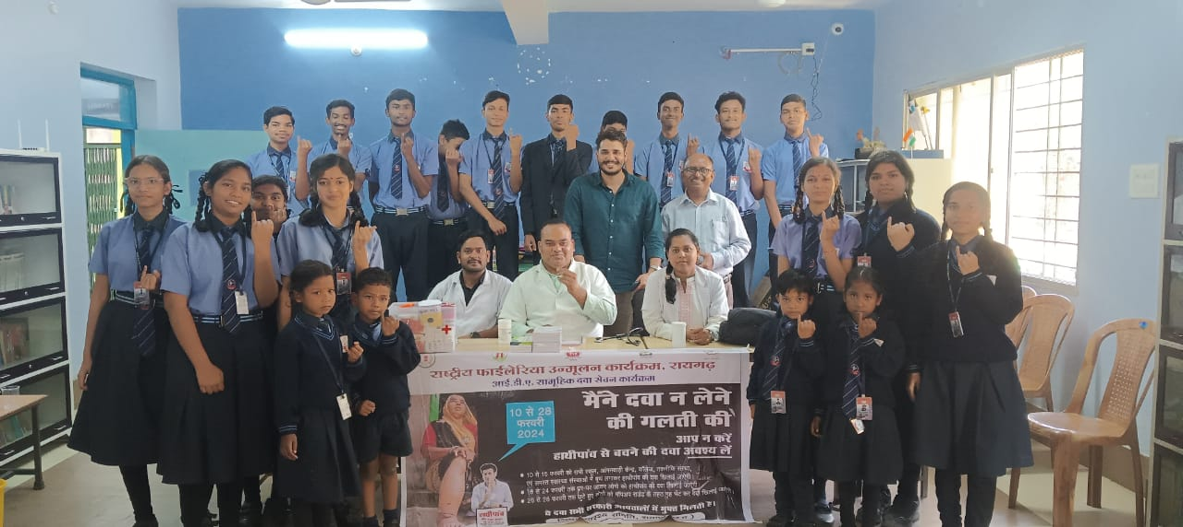
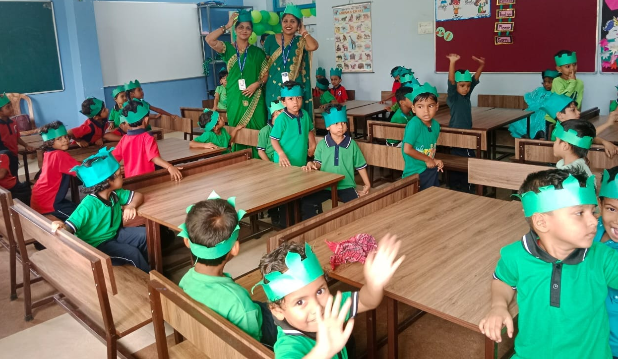
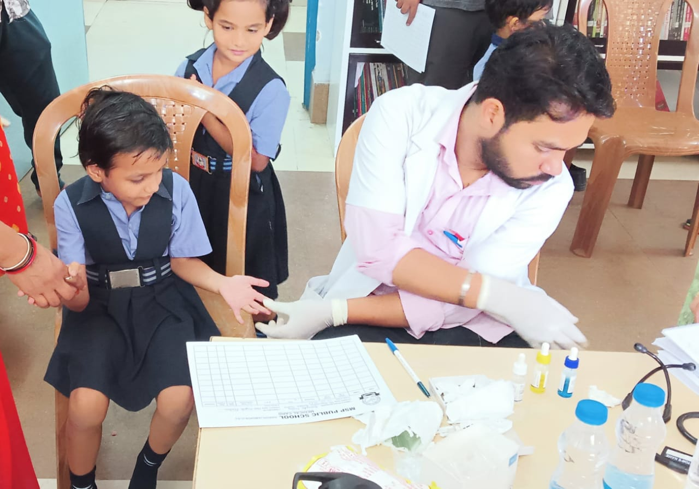
JULY - 2025
1 – Doctor’s Day
6- Muharram
7 – PT-I Begins
12 – PT-I Concludes
19 - Health and Hygiene Awareness Program (I to X) / Green Day (KG)
24 - Hareli
26 – PTM (KG to X) / Parent’s Day Celebration (KG)
DOCTOR’S DAY
GREEN DAY
SUN | MON | TUE | WED | THU | FRI | SAT
 |  | 1 | 2 | 3 | 4 | 5
6 | 7 | 8 | 9 | 10 | 11 | 12
13 | 14 | 15 | 16 | 17 | 18 | 19
20 | 21 | 22 | 23 | 24 | 25 | 26
27 | 28 | 29 | 30 | 31
Note- The details given above are tentative only. Changes may happened due to unavoidable circumstances.
MSP PUBLIC SCHOOL

Slide 7
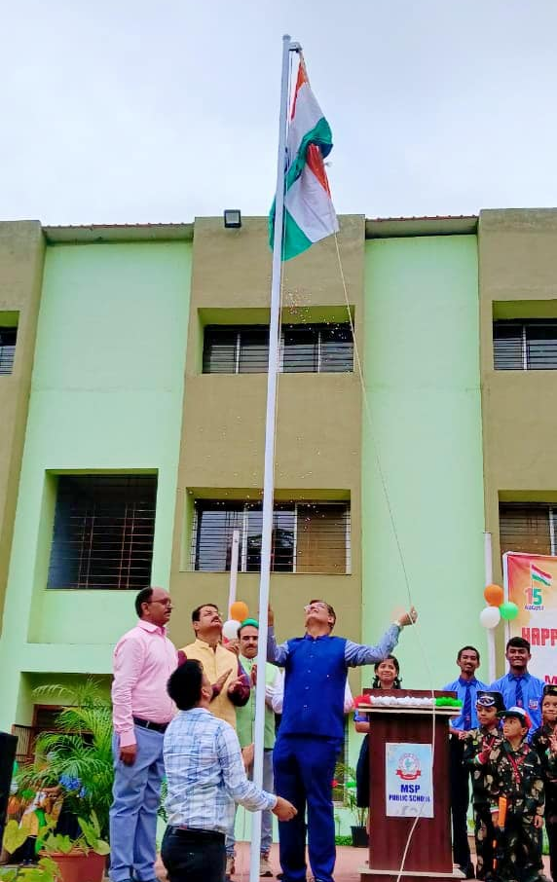
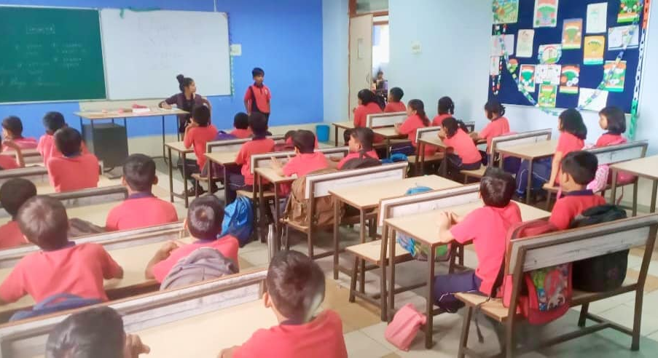
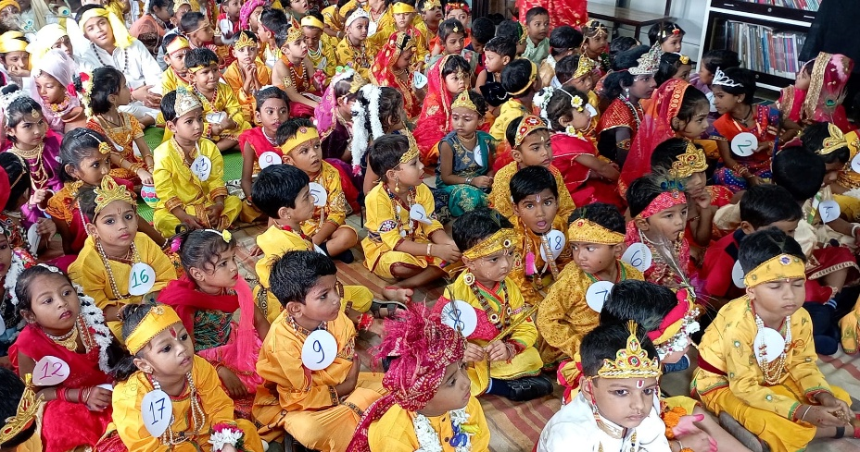
AUGUST - 2025
2 - English Recitation (VI to X) / Doha Chaupai (I to V) / Friendship Day (KG)
8 – Rakhi Making (KG)
9- Vishwa Aadivasi Diwas / Raksha Bandhan
14 – Janmashtami / Fancy Dress (KG)
15- Independence Day
16- Janmashtami
23 - English Recitation (I to V) / Doha Chaupai (VI to X)
26- Teej
27- Ganesh Chaturthi
25 - English ASL Begins (VI to IX)
30 - English ASL Concludes(VI to IX) / Seed Germination (I to V)
30 – PTM (KG)
RECITATION
INDEPENDENCE DAY
JANMASHTAMI CELEBRATION
SUN | MON | TUE | WED | THU | FRI | SAT
 |  |  |  |  | 1 | 2
3 | 4 | 5 | 6 | 7 | 8 | 9
10 | 11 | 12 | 13 | 14 |  | 16
17 | 18 | 19 | 20 | 21 | 22 | 23
24 | 25 | 26 | 27 | 28 | 29 | 30
31
Note- The details given above are tentative only. Changes may happened due to unavoidable circumstances.
15
MSP PUBLIC SCHOOL

Slide 8
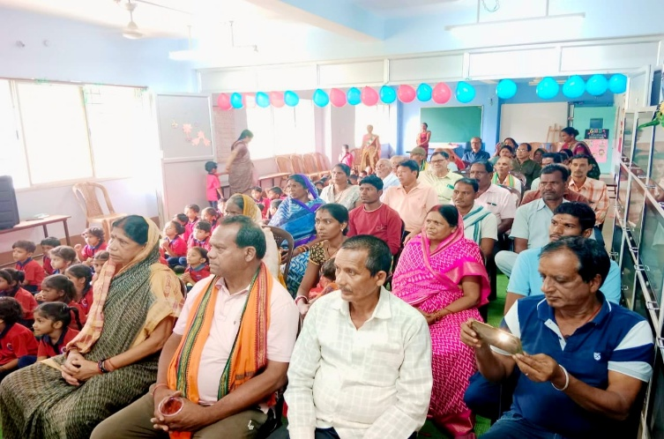
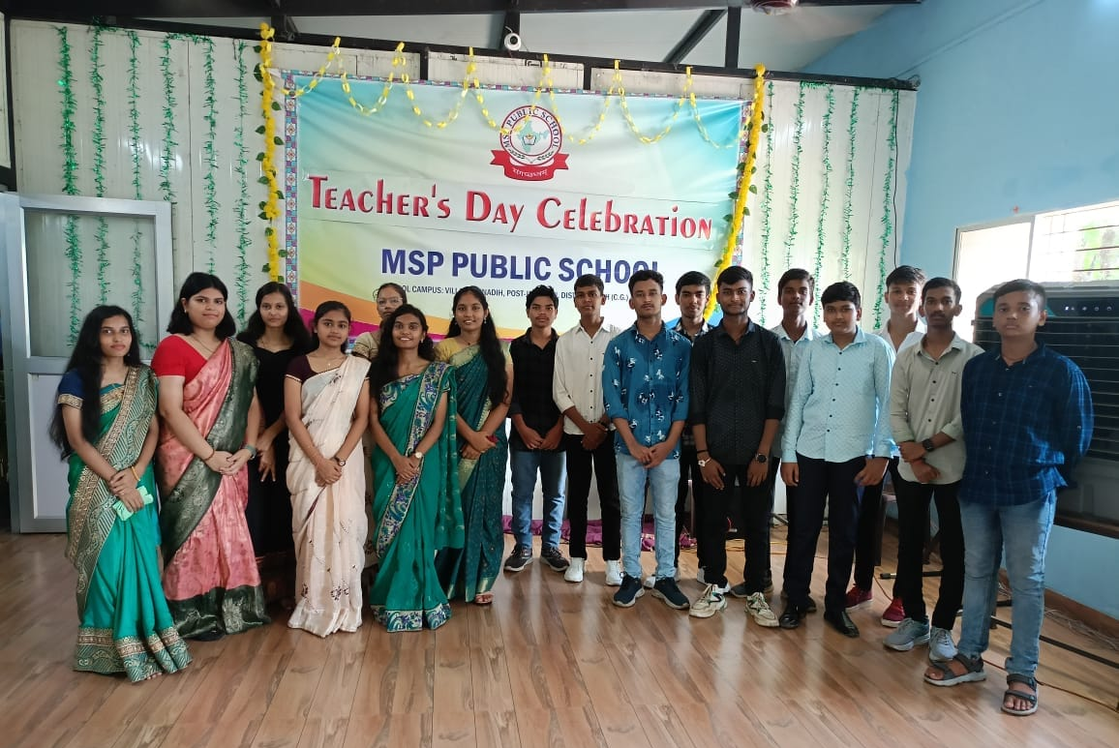
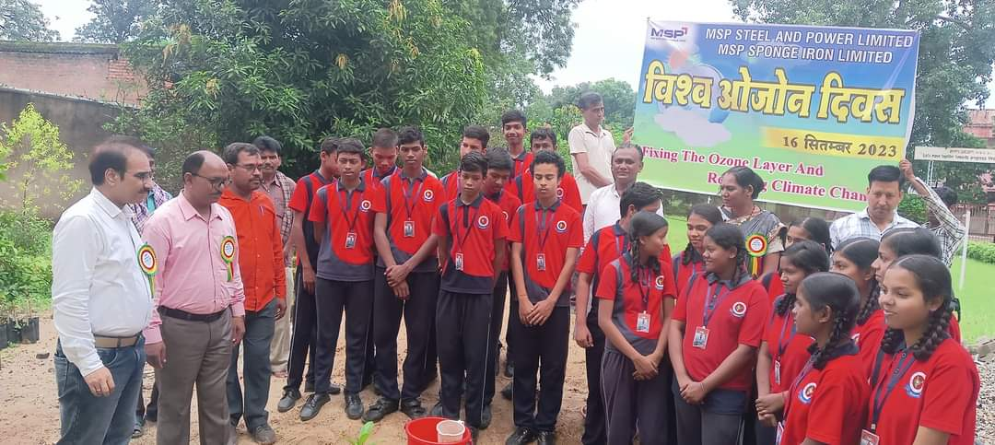
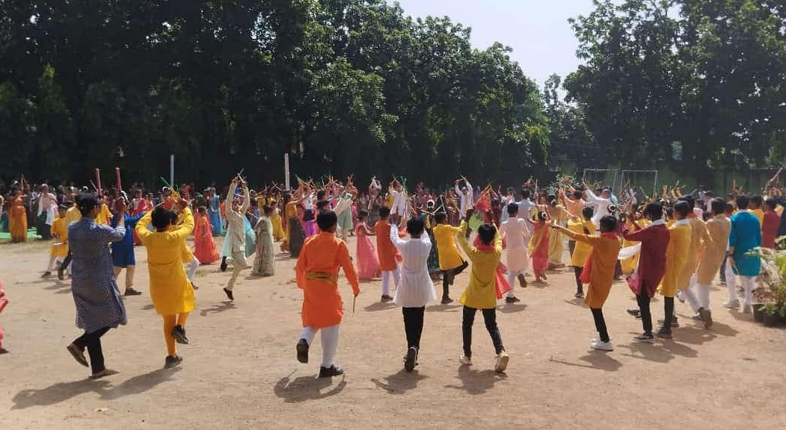
SEPTEMBER- 2025
GRAND PARENT’S DAY
4 – Grand Parent’s Day (KG)
5- Teacher’s Day Celebration
6 - Eid-e-Milad
15- Half Yearly Exam Begins
16- World Ozone Day
27- Half Yearly Exam Concludes
27- Navratri Celebration (KG)
29 - Dussehra Break Begins
TEACHER’S DAY
WORLD OZONE DAY
NAVRATRI CELEBRATION
SUN | MON | TUE | WED | THU | FRI | SAT
 | 1 | 2 | 3 | 4 | 5 | 6
7 | 8 | 9 | 10 | 11 | 12 | 13
14 | 15 | 16 | 17 | 18 | 19 | 20
21 | 22 | 23 | 24 | 25 | 26 | 27
28 | 29 | 30
Note- The details given above are tentative only. Changes may happened due to unavoidable circumstances.
MSP PUBLIC SCHOOL

Slide 9
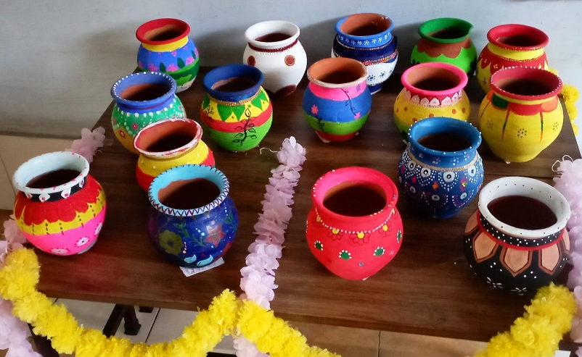
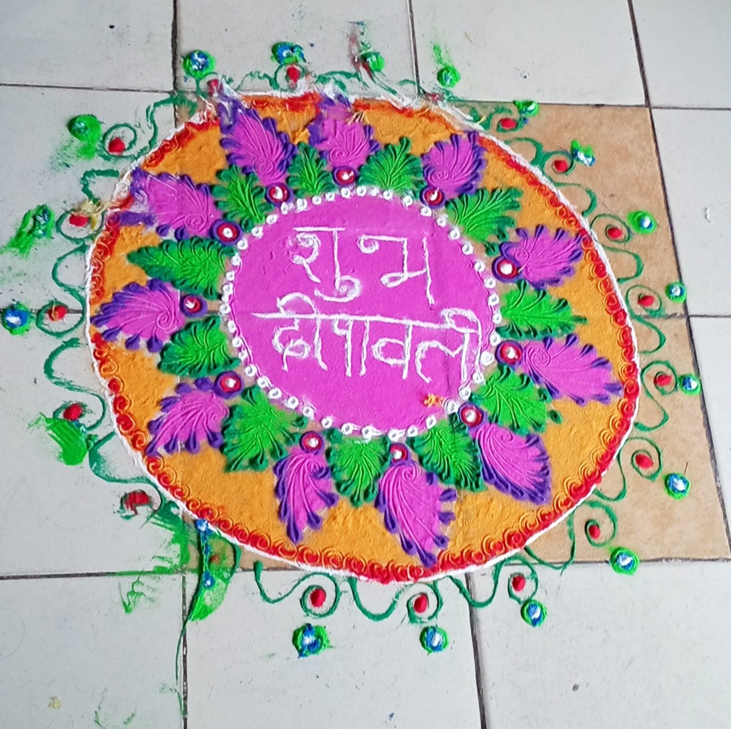
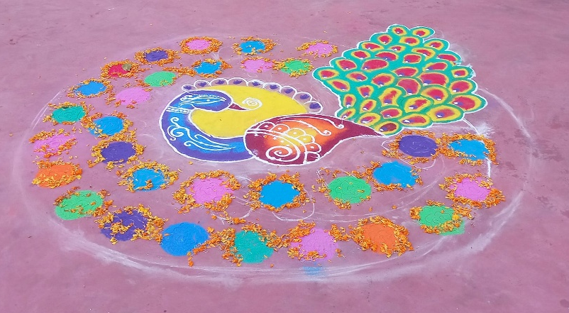
OCTOBER - 2025
2- Gandhi Jayanti & Shastri Jayanti / Dussehra
6 –School Reopens after Dussehra Break
9 – SOF -ICSO
11- English Extempore (VI to X) / Hindi Group Activities (I to V)
18 – PTM/ Half Yearly Result Declaration (I to X)
20 – Diwali Break Begins
27- Chhath Puja
28 – School Reopens after Diwali Break
31 – PTM (KG)
DIWALI CELEBRATION
SUN | MON | TUE | WED | THU | FRI | SAT
 |  |  | 1 | 2 | 3 | 4
5 | 6 | 7 | 8 | 9 | 10 | 11
12 | 13 | 14 | 15 | 16 | 17 | 18
19 | 20 | 21 | 22 | 23 | 24 | 25
26 | 27 | 28 | 29 | 30 | 31
Note- The details given above are tentative only. Changes may happened due to unavoidable circumstances.
MSP PUBLIC SCHOOL

Slide 10
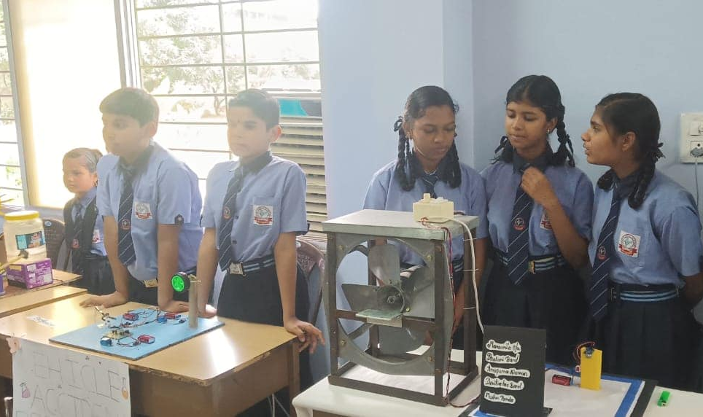
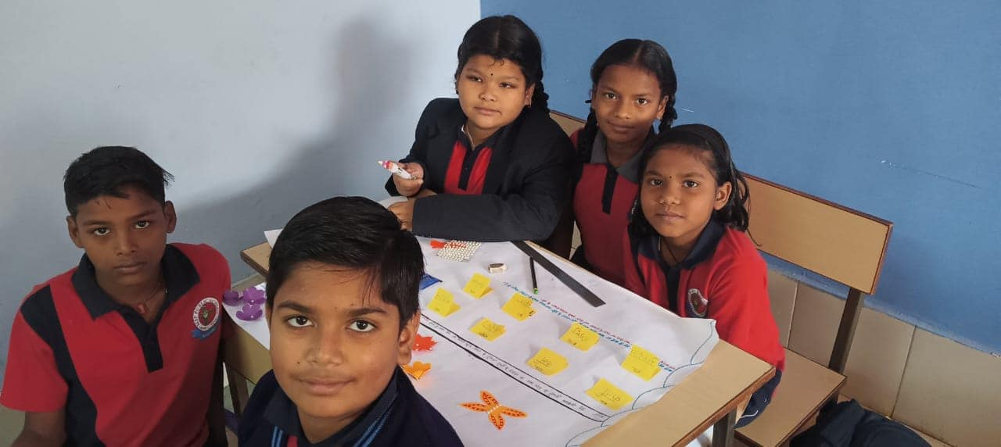
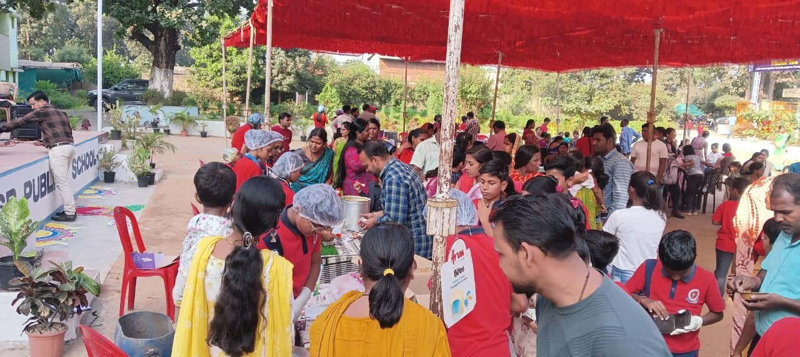
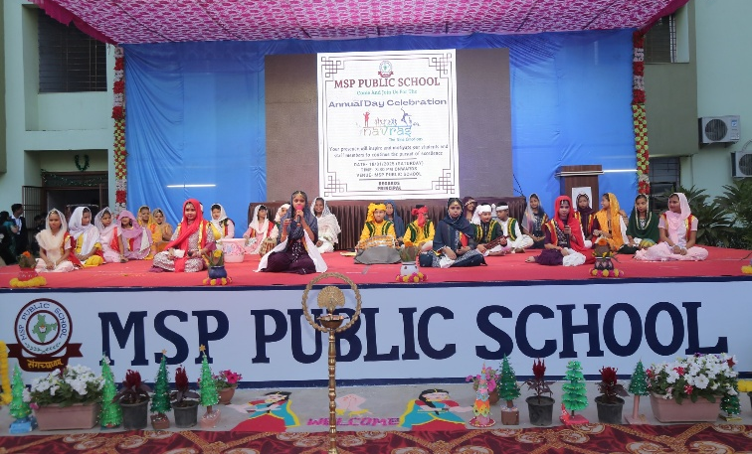
NOVEMBER - 2025
1- CG Foundation Day /
Dev Uthani Ekadashi
5- Guru Nanak’s Jayanti
7 – SOF - IGKO
11 – SOF - IEO
13 - SOF - NSO
8 – Science Exhibition
14 – Children’s Day Celebration / Aanand Mela
15 - English GD (VI to X) / Plant Irrigation (I to V)
22 -English Activities(I to V)/ Plant Germination (VI to X)
29 – Annual Day Celebration (Tentative)
SCIENCE EXHIBITION
GROUP ACTIVITIES
CHILDREN’S DAY
ANNUAL DAY
SUN | MON | TUE | WED | THU | FRI | SAT
 |  |  |  |  |  | 1
2 | 3 | 4 | 5 | 6 | 7 | 8
9 | 10 | 11 | 12 | 13 | 14 | 15
16 | 17 | 18 | 19 | 20 | 21 | 22
23 | 24 | 25 | 26 | 27 | 28 | 29
30
Note- The details given above are tentative only. Changes may happened due to unavoidable circumstances.
MSP PUBLIC SCHOOL

Slide 11
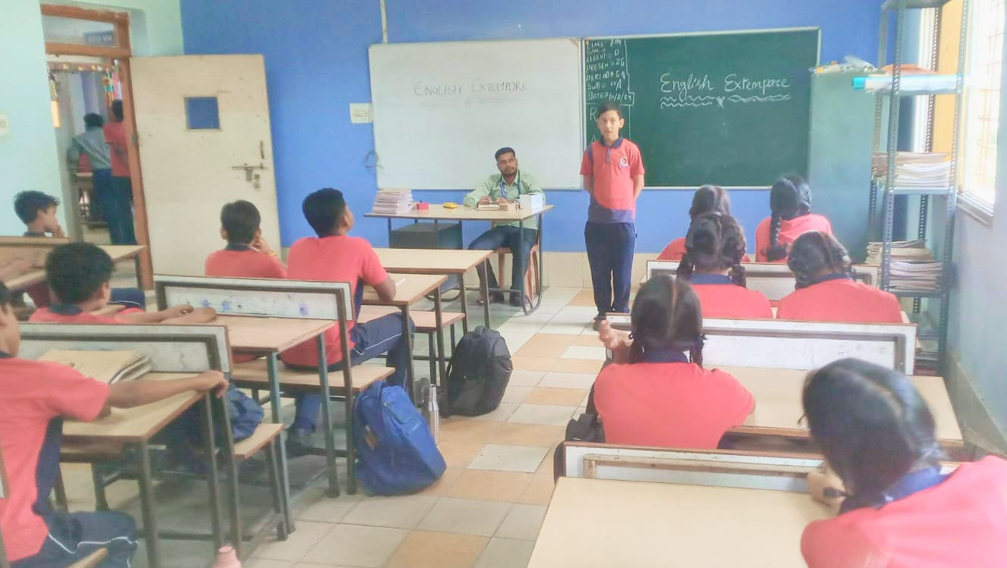
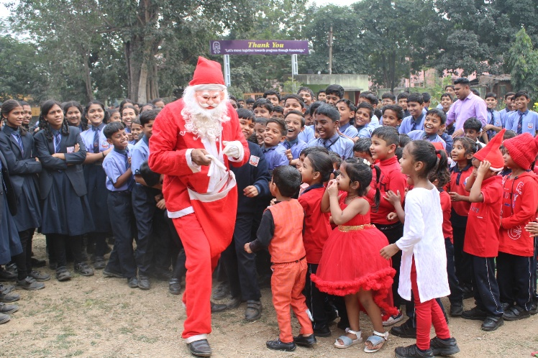
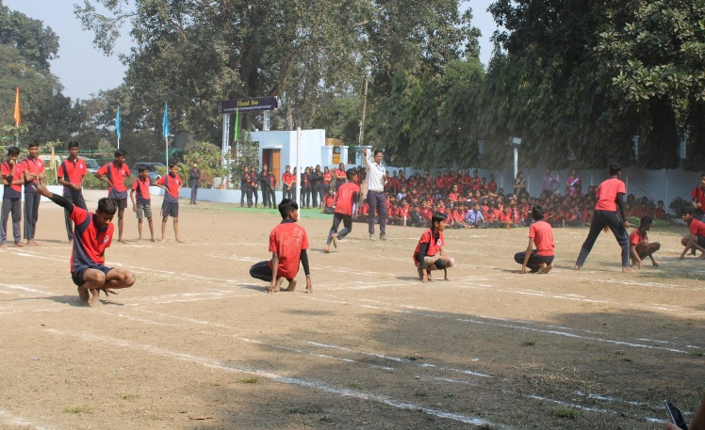
DECEMBER - 2025
EXTEMPORE
PLANTATION
6- English Extempore (I to V) / Hindi Debate (VI to X)
8- Pre Board-I Begins
13- Pre Board-I Concludes
13- Plantation (I to V) / Weeding (VI to IX)
12 – SOF - IMO
18- Guru Ghasidas Jayanti
23- PTM (Class X & KG)
24 – Annual Sports
24- Christmas Day Celebration (KG)
25- Winter Break Begins
CHRISTMAS DAY
SPORTS DAY
Note- The details given above are tentative only. Changes may happened due to unavoidable circumstances.
SUN | MON | TUE | WED | THU | FRI | SAT
 | 1 | 2 | 3 | 4 | 5 | 6
7 | 8 | 9 | 10 | 11 | 12 | 13
14 | 15 | 16 | 17 | 18 | 19 | 20
21 | 22 | 23 | 24 | 25 | 26 | 27
28 | 29 | 30 | 31
MSP PUBLIC SCHOOL

Slide 12
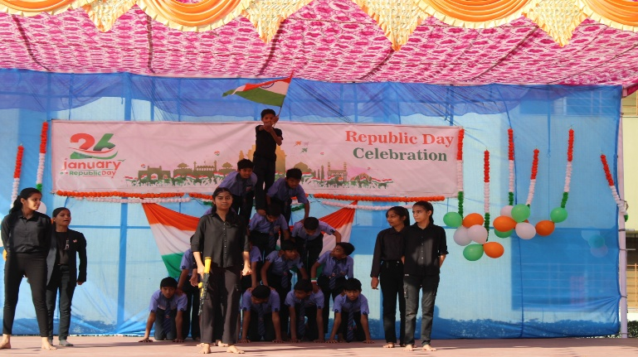
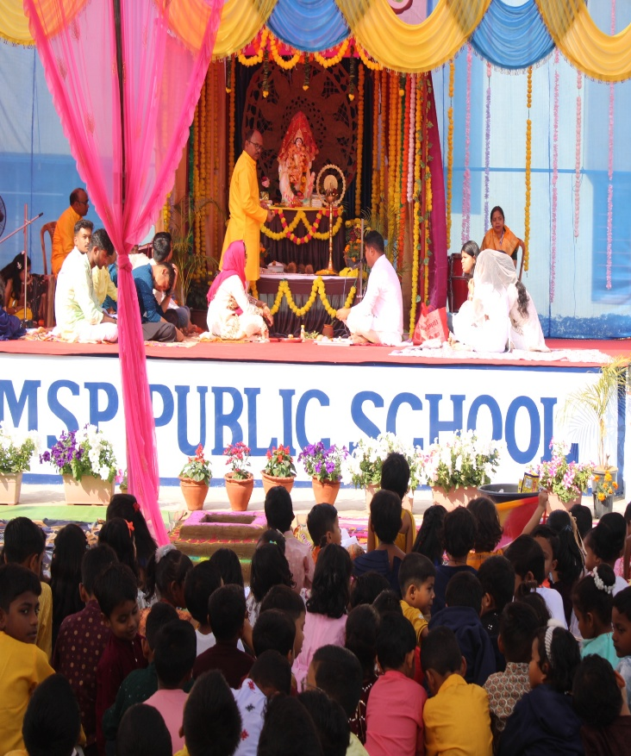
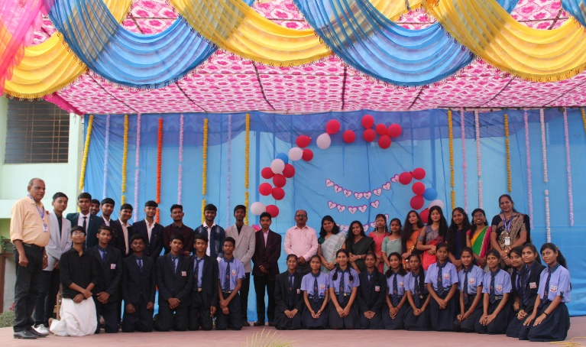
JANUARY - 2026
REPUBLIC DAY
1- New Year Day
2- School Reopens
5 - Pre-Board II (Class X),
PT-II (I to IX) Begin
10 - Pre-Board II (Class X),
PT-II (I to IX) Conclude
10 – Kite Making (KG)
14- Makar Sankranti
17 – Math & Science Quiz
22 – SOF - IHO
23 – Vasant Panchami
24- PTM (KG To X)
26- Republic Day
31 – Farewell Party
FAREWELL
VASANT PANCHAMI
SUN | MON | TUE | WED | THU | FRI | SAT
 |  |  |  | 1 | 2 | 3
4 | 5 | 6 | 7 | 8 | 9 | 10
11 | 12 | 13 | 14 | 15 | 16 | 17
18 | 19 | 20 | 21 | 22 | 23 | 24
25 |  | 27 | 28 | 29 | 30 | 31
Note- The details given above are tentative only. Changes may happened due to unavoidable circumstances.
26
MSP PUBLIC SCHOOL

Slide 13
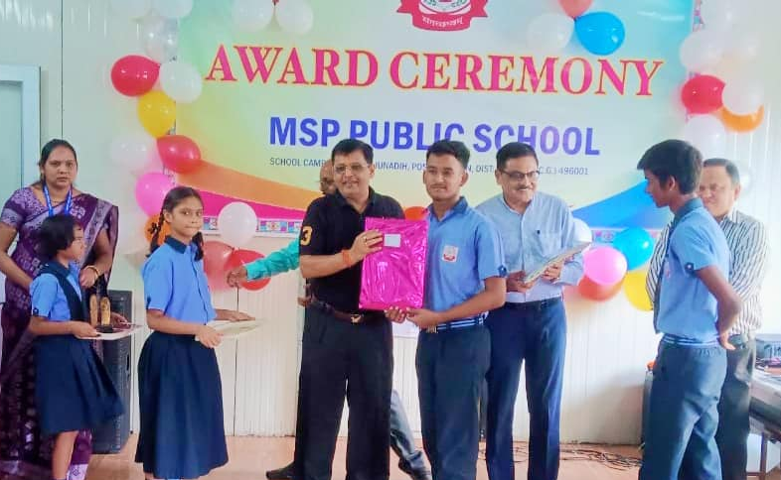
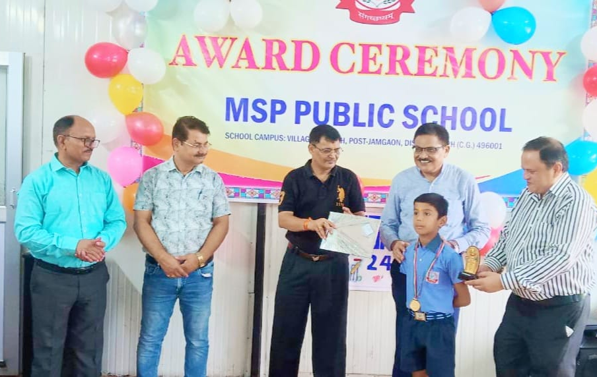
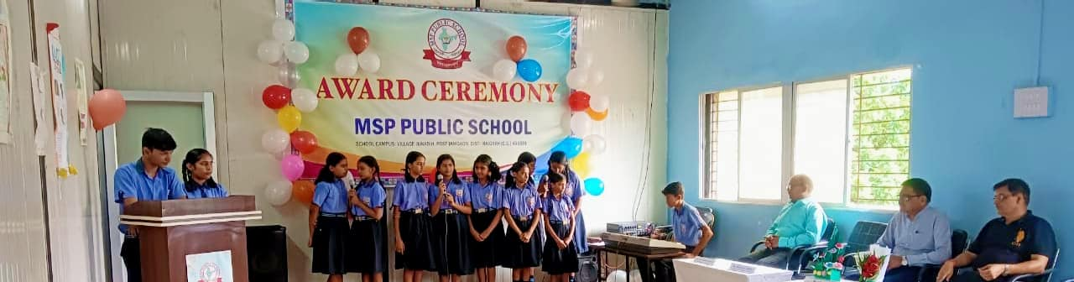
FEBRUARY - 2026
15 – Maha Shivaratri
18 – Annual Exam Begins
AWARD CEREMONY
Note- The details given above are tentative only. Changes may happened due to unavoidable circumstances.
SUN | MON | TUE | WED | THU | FRI | SAT
1 | 2 | 3 | 4 | 5 | 6 | 7
8 | 9 | 10 | 11 | 12 | 13 | 14
15 | 16 | 17 | 18 | 19 | 20 | 21
22 | 23 | 24 | 25 | 26 | 27 | 28
MSP PUBLIC SCHOOL

Slide 14
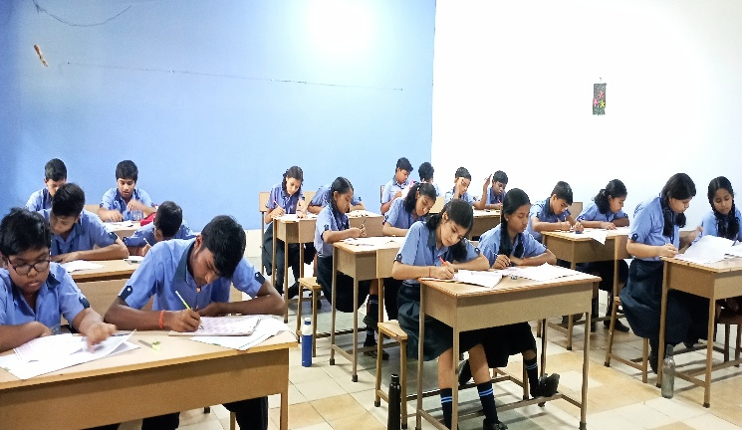
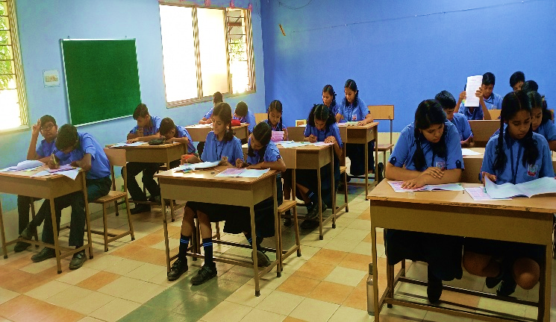
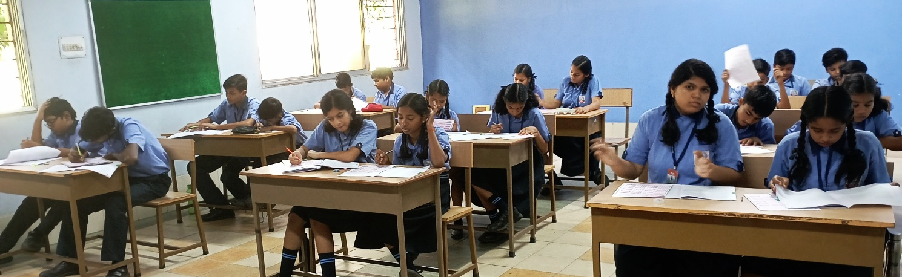
MARCH - 2026
2 – Annual Exam Concludes
4 – Holi
21 – Eid-ul-Fitar
26 – Ram Navami
28 - PTM/ Annual Result Declaration (KG to IX)
EXAMINATION|RESULT|PTM
Note- The details given above are tentative only. Changes may happened due to unavoidable circumstances.
SUN | MON | TUE | WED | THU | FRI | SAT
1 | 2 | 3 | 4 | 5 | 6 | 7
8 | 9 | 10 | 11 | 12 | 13 | 14
15 | 16 | 17 | 18 | 19 | 20 | 21
22 | 23 | 24 | 25 | 26 | 27 | 28
29 | 30 | 31
MSP PUBLIC SCHOOL

